Slide 1
Chapter 6:
Geometric Analysis: The Gap Property
By azam sadeghian

Slide 2
Introduction
the weight of a spanner(size) is a measure to be optimized.
To analyze the weight, we need tools for estimating the weight of Euclidean graphs that satisfy a certain property.
Geometric analysis: Let S be a set of n points in R^{d} , and let E be a set of(directed or undirected) edges whose endpoints belong to S and that satisfy some property P. Find a good upper bound on wt(E).

Slide 3
Relation between this problem and computing a spanner with low weight
Step 1: Devise a property P for which we can prove a good upper bound for wt(E).
Step 2: Design an algorithm that computes a spanner whose edge set satisfies property P.

Slide 4
Topics:
gap property and gap theorem
a lower bound on the maximum possible weight of any set of edges satisfying the gap property
An upper bound for points in the unit cube
A useful geometric lemma
Worst-case analysis of the 2-Opt algorithm for the traveling salesperson problem

Slide 5
The gap property:.
A set of directed edges satisfies the gap property, if the sources of any two distinct edges are “far” apart (relative to the length of the shorter of the two edges). If this condition also holds for the sinks of any two distinct edges, then the edge set satisfies the strong gap property
Definition 6.1.1 (Gap Property). Let w ≥ 0 be a real number, and let E be a set of directed edges in R^{d} .
1. We say that E satisfies the w-gap property if for any two distinct edges (p, q) and (r, s) in E, we have
|pr| > w* min(|pq|, |rs|).
2. We say that E satisfies the strong w-gap property if for any two distinct edges (p, q) and (r, s) in E, we have
|pr| > w* min(|pq|, |rs|)
and
|qs| > w* min(|pq|, |rs|).

Slide 6
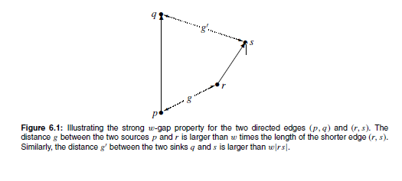

Slide 7
Theorem 6.1.2 (Gap Theorem).
Let S be a set of n points in R^{d} , and let E ⊆ S × S be a set of directed edges that satisfies the w-gap property.
1. If w ≥ 0, then each point of S is the source of at most one edge of E.
2. If w > 0, then wt(E) < (1 + 2/w) * wt(MST(S)) log n, where MST(S) denotes a minimum spanning tree of S.
3. If w ≥ 0, and E satisfies the strong w-gap property, then each point of S is the sink of at most one edge of E.

Slide 8
proof of Gap Theorem
1 and 3: Let (p, q) and (r, s) be two distinct edges of E. by definition
|pr| > w* min(|pq|, |rs|) and |qs| > w* min(|pq|, |rs|)
immediately implies |pr| > 0 and | qs | > 0. Therefore, p ≠ r and q ≠ s
2: assume that w > 0 and m be the number of edges in E. if m = 1 claim holds.
If m ≥ 2:
m is even: We claim that E contains a subset E ‘ of size m/2, such that wt(E ‘) < (2/w) * wt(MST(S)). To prove this claim, we consider a shortest traveling salesperson tour TSP(S) of S, and number the points of S such that TSP(S) = (p₁, p₂, . . . , p_{n}, p₁). Now we walk along this tour, starting at p₁, and consider the order in which we visit the sources of the edges of E. (We know that all sources are distinct. Hence, this order is uniquely defined.) We number the edges of E according to this order as e₁, e₂, . . . , e_{m}. For each i with 1 ≤ i ≤ m, let |e_{i} | denote the length of e_{i} , and let k_{i} be the index such that edge e_{i} has point p_{ki} as its source. Observe that
1 ≤ k₁ < k₂ < . . . < k_{m} ≤ n.

Slide 9
Proof: wt(E) < (1 + 2/w) * wt(MST(S)) log n
Let i be an integer with 1 ≤ i ≤ m/2, and consider the edges e_{2i−1} and e_{2i} . Let T_{i} be the portion of TSP(S) that starts at p_{k2i−1} and ends at p_{k2i} , that is,
By triangle inequality
On the other hand, since e_{2i−1} and e_{2i} satisfy the w-gap property, we have
Combining these two inequalities
min(|e_{2i−1}|, |e_{2 i}|) <1/w * wt(T_{i})
(Since the portions T_{i} , 1 ≤ i ≤ m/2, are pair wise disjoint, the latter inequality implies that )
so E’ with size m/2 and weight is less than (1/w) * wt(TSP(S)) is obtained:
Since wt(TSP(S)) ≤ 2 * wt(MST(S)) (in chapter 1)
→ wt(E’) < (2/w) * wt(MST(S)).

Slide 10
Proof: wt(E) < (1 + 2/w) * wt(MST(S)) log n
If m is an odd: integer with m ≥ 3, then a similar argument implies that E contains a subset E’ of size (m + 1)/2 such that
wt(E’) < (1 + 2/w) * wt(MST(S)).
Proof: by induction on m we prove
wt(E) < (1 + 2/w) *wt(MST(S)) log m.
(This will imply the second claim, because m ≤ n.)
To start the induction, assume that m = 2. Since m is even, the set E’ contains an edge whose length is less than (2/w)*wt(MST(S)). The length of the other edge of E is clearly less than or equal to wt(MST(S))

Slide 11
Proof: wt(E) < (1 + 2/w) * wt(MST(S)) log n
Let m ≥ 3, and assume that lemma holds for all sets of edges that have less than m elements and satisfy the w-gap property.
Let E’ be a subset of E containing at least m/2 elements such that
wt(E’) < (1 + 2/w) * wt(MST(S)).
We have proved above that E’ exists.
The set E \ E’ has size at most m/2 and satisfies the w-gap property. Hence, by the induction hypothesis, we have
wt(E \ E’) < (1 + 2/w) * wt(MST(S)) log(m/2).
Since wt(E) = wt(E’) + wt(E \ E’), it follows that lemma holds for the set E.

Slide 12
Notation of Gap Theorems proof
The optimal TSP tour is used in the proof.
The edges of E are numbered according to the order in which their sources are visited by an optimal traveling salesperson tour TSP(S).
For a given positive real number w, the shorter of any two consecutive edges has length less than 1/w times the portion of TSP(S) that is bounded by their sources.
Therefore, E contains a subset E’ of size about half the size of E, such that :
wt(E’) = O(wt(TSP(S))) = O(wt(MST(S))).
Applying this argument recursively to E \ E’ proves that wt(E) = O(wt(MST(S)) log n).

Slide 13
Remark 6.1.3. Besides the triangle inequality, we did not use any geometric properties in the proof of the Gap Theorem. Consequently, this theorem also holds for the case when E is a set of edges with weights from an arbitrary metric space.
Remark 6.1.4. In the proof, the lengths of the edges in E are “charged” to the TSP tour edges. However, the proof does not need the tour to be explicitly computed. It merely requires its existence.

Slide 14
6.2 A lower bound
Theorem 6.2.1. Let w be a real number with 0 < w < 1, let k ≥ 2 be an integer, and let n = 3^{k} − 1.
There exists a set S of n points on the real line and a set E ⊆ S × S of directed edges, such that E satisfies the strong w-gap property, and
wt(E) =Ω (wt(MST(S)) log n).

Slide 15
proof : For each i with 0 ≤ i < k, we partition the interval [0, 1] into 3^{i} intervals, each having length 1/3^{i} . Thus, for j = 0, 1, . . . , 3^{i} − 1, the j -th interval in this partition is [j/ 3^{i} , (j + 1)/ 3^{i} ]. For each such j , we divide the j -th interval into three subintervals of equal length, and define e_{ij} to be the middle of these three subintervals. Thus, e_{ij} = [j/ 3^{i} + 1/ 3^{i +1}, j/ 3^{i} + 2/ 3^{i +1}].
We consider e_{ij} to be an edge on the real line, and define
E_{i} := {e_{ij} : j = 0, 1, . . . , 3^{i} − 1}.
Finally, we define
E := E₀ ∪ E₁ ∪ E₂ ∪ ・ ・ ・ ∪ E_{k−1}
and S ⊆ R to be the set of endpoints of the edges in E.

Slide 16
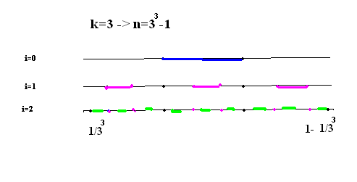

Slide 17
Proof :wt(E) =Ω (wt(MST(S)) log n).
The number of edges in E =
Let n denote the number of elements in S. Since the endpoints of all edges in E are pairwise distinct, we have n = 3^{k} −1 (k= log ₃ n +1) and that E satisfies the strong w-gap property, for any assignment of directions to the edges in E;
In order to prove the second part of the claim, we need to analyze the weight of E and the weight of a minimum spanning tree of S. Since the total weight of all edges in E_{i} is equal to 1/3, we have
wt(E) = k/3 = 1/ 3 log₃(n + 1) = Ω(log n).
The minimum spanning tree of S basically consists of the sorted sequence of the elements of S. Since the minimum and maximum elements of S are equal to 1/3^{k} and 1 − 1/3^{k}, respectively, it follows that
wt(MST(S)) = 1 − 2/ 3^{k} < 1.
By combining these bounds, it follows that
wt(E)/wt (MST(S)) > wt(E) = Ω(log n) → wt(E)>Ω (log n) wt (MST(S))

Slide 18
6.3 An upper bound for points in the unit cube
consider the case when these endpoints are in the d-dimensional unit cube [0, 1]^{d}.
the weight of a minimum spanning tree of such a point set is O(n^{1−1/d} )
The theorem below states that the same upper bound holds for the weight of a set of edges that satisfies the gap property.
Let
Γ denotes Euler’s gamma-function.
a d-dimensional ball of radius R has volume c_{d} R^{d} .

Slide 19
An upper bound for points in the unit cube
Theorem 6.3.1. Let S be a set of n points in the d-dimensional unit cube [0, 1]^{d} , where d ≥ 2. Let w be a real number with
0 < w ≤ 2/ √d, and let E ⊆ S × S be a set of directed edges that satisfies the w-gap property. Then
wt(E) ≤ c_{dw}n^{1−1/d} ,
where
c_{dw} = 1 + 2^{2d+2}/c_{d}w^{d}

Slide 20
proof:wt(E) ≤ 1 + 2^{2d+2}/c_{d}w^{d *}n^{1−1/d}
Proof : each point of S is the source of at most one edge of E. Therefore, the set E contains at most n edges. We partition the edges of E into two subsets. An edge (p, q) is called long, if |pq| > n ^{−1/d} , and short otherwise.
Let E_{l} be the set containing all long edges of E, and let E_{s} be the set containing all short edges of E.
for E_{s}
wt(E_{s} ) ≤ |E_{S}| n ^{−1/d} ≤ n^{1−1/d} .
2) For E_{l}
For any integer j , we define the interval I_{j} ⊆ R by
Using these intervals, we further partition the set E into subsets
F_{j} := {(p, q) ∈ E : |pq| ∈ I_{j} }.

Slide 21
proof:wt(E) ≤ 1 + 2^{2d+2}/c_{d}w^{d *}n^{1−1/d}
Since long edges are of length more than n ^{−1/d} and at most √ d , we need to consider only sets F_{j} for integers j in the range
Max number of sources in every F_{j} ?
upper bound on the weight of a nonempty set F_{j} ?
Let k be the number of edges in F_{j} . We denote these edges by (p_{i}, q_{i} ), 1 ≤ i ≤ k. Let L := 2^{j}/n^{1/d} . Then for any i with 1 ≤ i ≤ k, we have
L < |p_{i}q_{i}| ≤ 2L.
Moreover, since the edges of E satisfy the w-gap property, we have
|p_{i}p_{i ‘}| > w* min(|p_{i}qi |, |p_{i’ ’}q_{i ‘}|) > wL
for any two distinct indices i and i’ . Hence, if we draw a d-dimensional ball B_{i} of radius wL/2 around each point p_{i} , 1 ≤ i ≤ k, then these balls are pairwise disjoint. Since wL/2 ≤ w √ d/2 ≤ 1, at least a fraction (1/2)^{d} of each ball B_{i} is contained in the unit Cube.

Slide 22
proof:wt(E) ≤ 1 + 2^{2d+2}/c_{d}w^{d *}n^{1−1/d}
Recall that a d-dimensional ball of radius R has volume c_{d}R^{d} . It follows that the total volume of all portions of the balls B_{i} inside the unit cube is greater than or equal to
This quantity must obviously be less than or equal to 1. Therefore,
.
Since each edge of F_{j} has length at most 2L (L := 2^{j}/n^{1/d} ), we get the upper bound

Slide 23
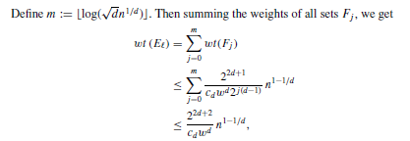
proof:wt(E) ≤ 1 + 2^{2d+2}/c_{d}w^{d *}n^{1−1/d}
where d ≥ 2.
Since wt(E) = wt(E_{s} ) +wt(E_{l}), the proof is complete.

Slide 24
6.4 A useful geometric lemma
Lemma 6.4.1. Let t , θ and w be real numbers, such that 0 < θ < π/4,
0 ≤ w < (cos θ − sin θ)/2, and t ≥ 1/(cos θ − sin θ − 2w). Let p, q, r, and s be points in R^{d} , such that
1. p ≠ q, r ≠ s,
2. angle(pq, rs) ≤ θ,
3. |rs| ≤ |pq|/ cos θ, and
4. |pr| ≤ w|rs|.
Then |pr| < |pq|, |sq| < |pq|, and t |pr| + |rs| + t |sq| ≤ t |pq|.

Slide 25
proof : Since
|rs| ≤ |pq|/ cos θ ( 0 < θ < π/4,)
|rs| < √ 2|pq and w < 1/2 and
|pr| ≤ w|rs|,
|pr| < |rs|/2.
Combining these two inequalities gives
|pr| < √ 2 |pq|/2 < |pq|.
Let l be the ray that emanates from r and that has the same direction
as the vector pq .Let v be the point on l , such that |rv| = |pq|. Observe that |pr| = |vq|. Let u be the orthogonal projection of s onto l , and let α be the angle between rs and l .
Then α = angle(pq, rs) ≤ θ,
sin α = |su|/|rs| and
cos α = |ru|/|rs|.

Slide 26
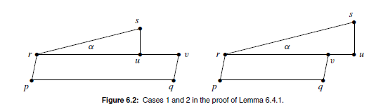
two cases, depending on whether |ru| ≤ |rv| or |ru| > |rv| is possible.

Slide 27
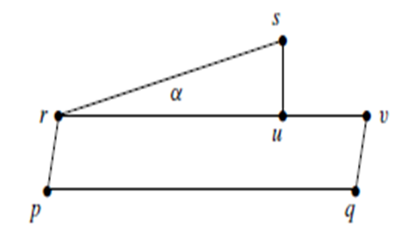
Proof: |sq| < |pq|
Case 1: |ru| ≤ |rv|.
To show that |sq| < |pq|, we apply the triangle inequality and simplify:
|sq| ≤ |su| + |uv| + |vq|
= |su| + |rv| − |ru| + |vq|
= |su| + |pq| − |ru| + |pr|
= |rs|(sin α − cos α) + |pq| + |pr|
≤ |rs|(sin θ − cos θ) + |pq| + w|rs|
= |pq| − |rs|(cos θ − sin θ − w)
Since w < (cos θ − sin θ)/2 and r = s, we conclude that |sq| < |pq|.
To prove the third claim, we have:
t |pr| + |rs| + t |sq| ≤ t |pr| + |rs| + t |pq| − t |rs|(cos θ − sin θ − w)
≤ tw|rs| + |rs| + t |pq| − t |rs|(cos θ − sin θ − w) t>1/cos θ − sin θ − 2w
= (1 − t(cos θ − sin θ − 2w)) |rs| + t |pq|≤ t |pq|.

Slide 28
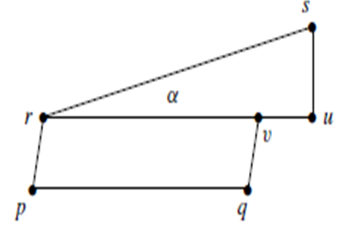

Proof: |sq| < |pq|
Case 2: |ru| > |rv|.
As in Case 1, we apply the triangle inequality and simplify:
|sq| ≤ |su| + |uv| + |vq|
= |su| + |ru| − |rv| + |vq|
= |rs|(sin α + cos α) − |pq| + |pr|
≤ |rs|(sin θ + cos θ) − |pq| + w|rs|
= |rs|(sin θ + w) + |rs| cos θ − |pq|
≤ |rs|(sin θ + w)
Since 0 < θ < π/4, we have tanθ < 1. Therefore, |sq| < |pq|.

Slide 29
Proof : t |pr| + |rs| + t |sq| ≤ t |pq|
We complete the proof by using (|sq|≤ |rs|(sin θ + w)
and the assumptions of the lemma. We have
t |pr| + |rs| + t |sq| ≤ t |pr| + |rs| + t |rs|(sin θ + w)
≤ tw|rs| + |rs| + t |rs|(sin θ + w)
= (1 + t(sin θ + 2w)) |rs|
= t |pq| − t |pq| + (1 + t(sin θ + 2w)) |rs|
≤ t |pq| − t |rs| cos θ + (1 + t(sin θ + 2w)) |rs|
= t |pq| − (t(cos θ − sin θ − 2w) − 1) |rs|
≤ t |pq|.
This completes the proof.

Slide 30
Application for lemma
Assume that we want to travel from vertex p to vertex q. Moreover, assume that there is a directed edge (r, s), such that (i) (r, s) is almost parallel to (p, q), (ii) |rs| is not much larger than |pq|, and (iii) r is close to p.
Then Lemma 6.4.1 states that we obtain a short path between p and q, by first traveling from p to r, then following the edge (r, s), and finally traveling from s to q.

Slide 31
6.5 Worst-case analysis of the 2-Opt algorithm for the traveling salesperson problem
the2-Opt algorithm for the Euclidean traveling salesperson problem outputs a set of edges that can be partitioned into a constant number of subsets, each of which satisfies the gap property. Hence, the 2-Opt algorithm computes, for a given set S of n points in R^{d} , a tour of length O(log n) times the length of an optimal traveling salesperson tour of S.
In the 2-Opt algorithm, we start with an arbitrary initial tour, and improve it by making small local changes. To be more precise, let T be the current tour along the points of S. We assume that the edges of T are directed. As long as T contains distinct edges (p, q) and (r, s), such that
|pr| + |qs| < |pq| + |rs|, (6.5)
the 2-Opt algorithm improves T by replacing the two edges (p, q) and (r, s) by the edges (p, r) and (q, s), and reversing the direction of the edges on the path from q to r.

Slide 32
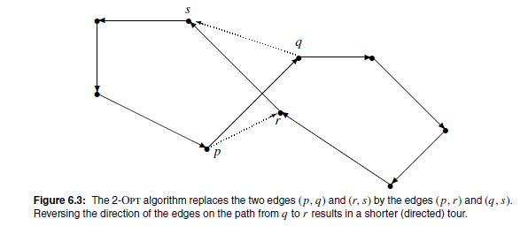
2-Opt algorithm

Slide 33
2-Opt algorithm
The 2-Opt algorithm results in a tour T₀ is called 2-optimal. Computing the worst-case value for the approximation factor wt(T₀)/wt (TSP(S)) was a long-standing open problem. As mentioned above, we use the gap property to show that this approximation factor is O(log n).
To prove this claim, let T₀ be a tour along the points of S that is 2-optimal. Then for any two distinct edges (p, q) and (r, s) of T₀, we have
|pr| + |qs| ≥ |pq| + |rs
The following lemma states that any two distinct edges of T₀ that are approximately parallel satisfy the gap property.We choose real numbers θ and w such that 0 < θ < π/4 and 0 < w < (cos θ − sin θ)/2.

Slide 34
Lemma 6.5.1. Let (p, q) and (r, s) be two distinct edges of T₀, and assume that angle(pq, rs) ≤ θ. Then
|pr| > w* min(|pq|, |rs|),
i.e., (p, q) and (r, s) satisfy the w-gap property.
Proof: We may assume without loss of generality that |rs| ≤ |pq|. The proof is by contradiction.
So assume that |pr| ≤ w|rs|. Let t := 1/(cos θ − sin θ − 2w). Then, by Lemma 6.4.1, we have
t |pr| + |rs| + t |sq| ≤ t |pq|.
Since the tour T₀ is 2-optimal, |pr| + |qs| ≥ |pq| + |rs|. implies that
|pq| ≤ |pr| + |sq| − |rs|.→
t |pr| + |rs| + t |sq| ≤ t |pr| + t |sq| − t |rs|,
which rewrites to (1 + t )|rs| ≤ 0. This is clearly a contradiction, because r = s.

Slide 35
By Choosing constants θ and w we have:
Theorem 6.5.2. Let d ≥ 2 be an integer constant, and let S be a set of n points in R^{d} . The 2-Opt algorithm computes a tour along the points of S, whose length is O(log n) times the length of an optimal traveling salesperson tour of S.
Proof: We partition the edges of T₀ into O(1/θ^{d−1}) subsets, such that any two edges within the same subset make an angle of at most θ . It follows from Lemma 6.5.1 and Theorem 6.1.2 that the weight of the edges within each subset is less than (1 +2/w) *wt(MST(S)) log n. Hence, by using the fact that wt(MST(S)) ≤ wt(TSP(S)), it follows that
Hence, the worst-case approximation ratio of the 2-Opt algorithm is O(log n).

