Slide 1
Undirected BFS
Maedeh Mehravaran
Big data
1394

Slide 2





Layers
$L(i)$:= set of vertices with distance i to the root
$$L(2)$$
$$L(1)$$
$$L(3)$$
$$L(0)$$

Slide 3




Computing Layers Inductively
Observation: $L(i+1) = N(L(i)) − L(i) − L(i−1)$
$$L(2)$$
$$N(2)$$
$$L(1)$$
$$L(3)$$
$$L(0)$$

Slide 4
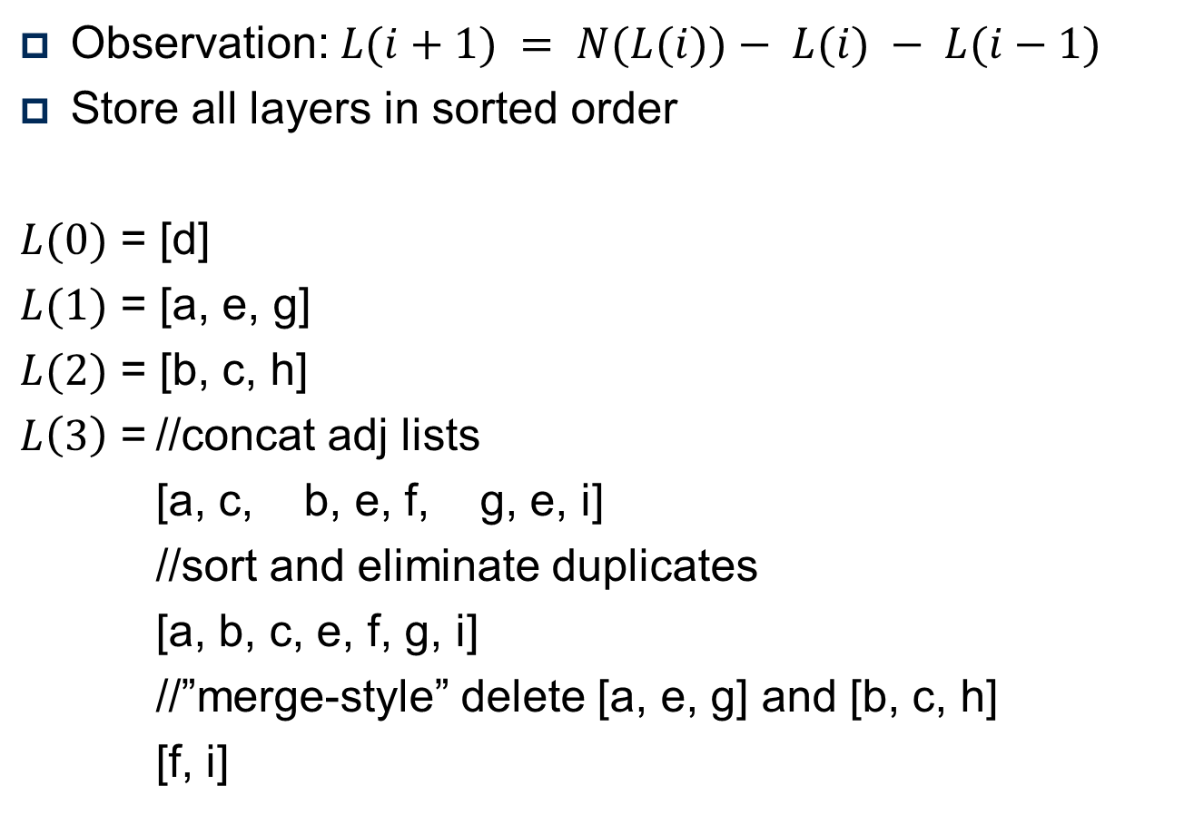



Computing Layers Inductively
Observation: $L(i+1) = N(L(i))− L(i) − L(i−1)$
Store all layers in sorted order
$L(0)$ = [d]
$L(1)$ = [a, e, g]
$L(2)$ = [b, c, h]
$L\left(3\right)$ = //concat adj lists
[a, c, b, e, f, g, e, i]
//sort and eliminate duplicates
[a, b, c, e, f, g, i]
//”merge-style” delete [a, e, g] and [b, c, h]
[f, i]
$$L(2)$$
$$L(1)$$
b
a
c
$$L(0)$$
d
e
f
g
h
i

Slide 5



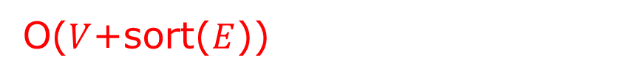
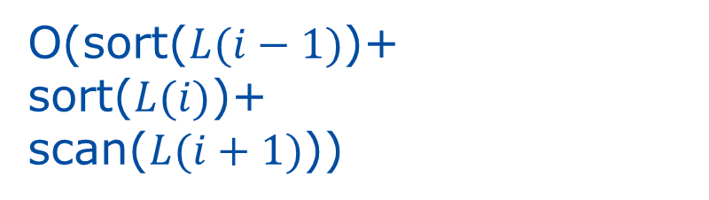

Undirected BFS algorithm
Recap:
sort(a)+sort(b) = O(sort(a+b))
scan(a)+scan(b) = O(scan(a+b))
UndirectedBFS( r )
{
$L(−1)$:= $∅;$
$L(0)$:= $\{r\}$;
$i$ := 0;
While $L(i) ≠∅$
$L(i+1)$ := union adjacency lists of vertices in $L(i)$;
Remove duplicates from $L(i+1)$;
Remove $L(i−1)$ and $L(i)$ from $L(i+1)$;
$i$ := $i+1$;
}
Total: O($V$+scan($E$))
Total: O(sort($E$))
Total: O(sort($V$))
O(sort($L(i−1)$)+
sort($L(i)$)+
scan($L(i+1)$))
O($V$+sort($E$))

Slide 6
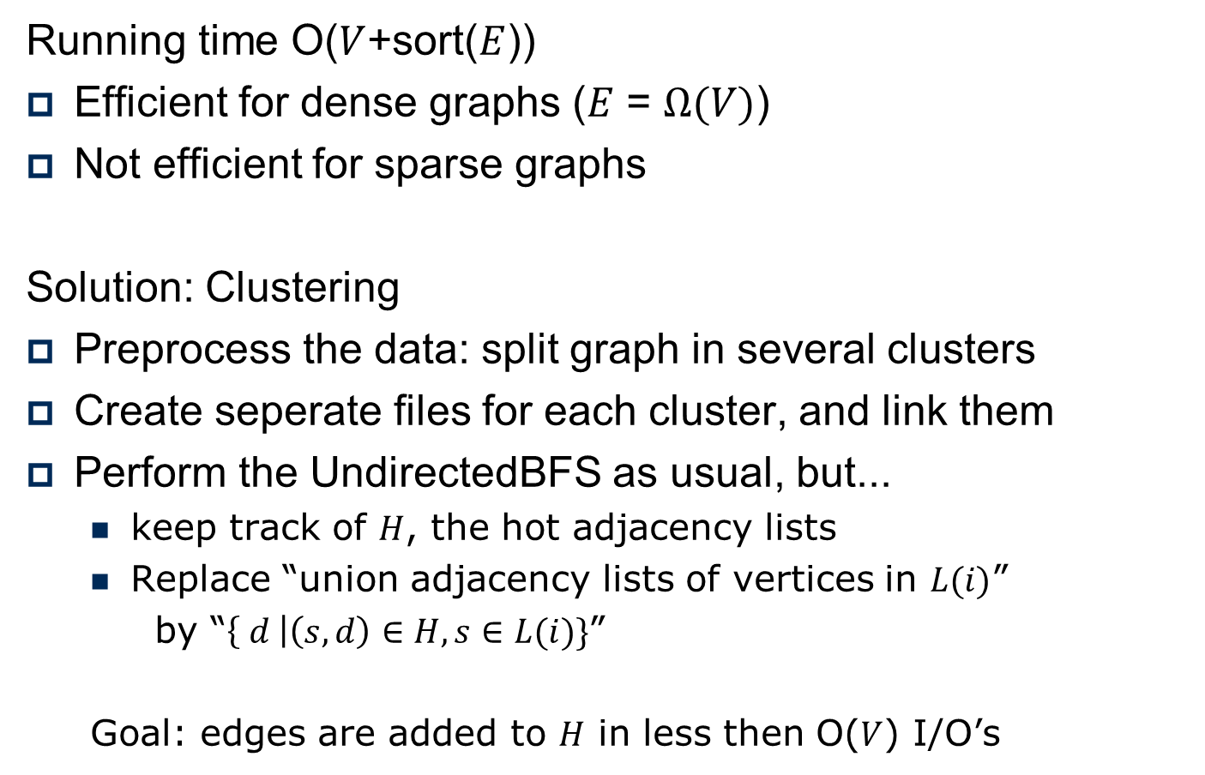
Faster Undirected BFS?
Running time O($V$+sort($E$))
Efficient for dense graphs ($E$ = $Ω(V)$)
Not efficient for sparse graphs
Solution: Clustering
Preprocess the data: split graph in several clusters
Create seperate files for each cluster, and link them
Perform the UndirectedBFS as usual, but...
keep track of $H$, the hot adjacency lists
Replace “union adjacency lists of vertices in $L(i)$”
by “$\left\{ d \right|\left(s, d\right)∈H, s∈L(i)\}$”
Goal: edges are added to $H$ in less then O($V$) I/O’s

Slide 7
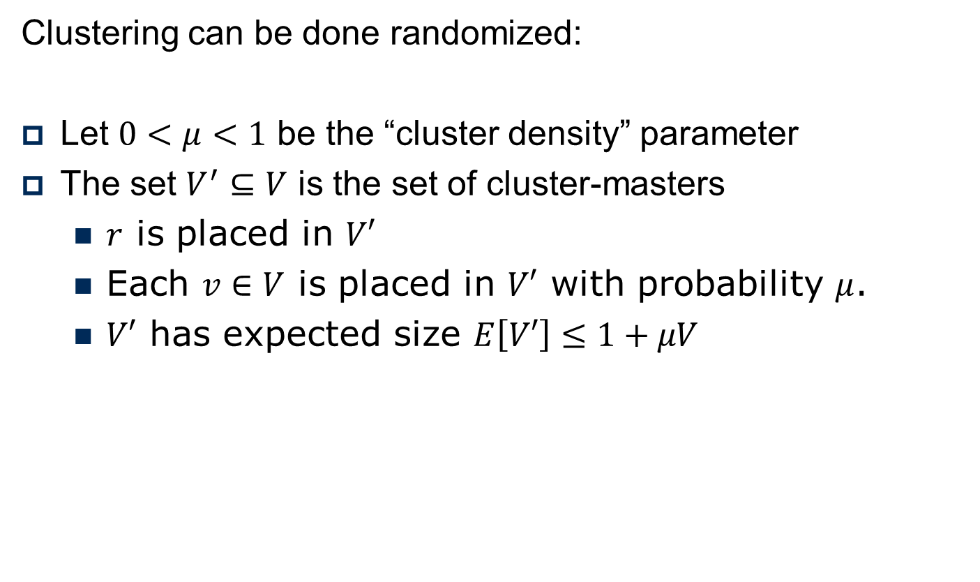
Faster Undirected BFS: Clustering
Clustering can be done randomized:
Let $0<μ<1$ be the “cluster density” parameter
The set $V^{′}⊆V$ is the set of cluster-masters
$r$ is placed in $V′$
Each $v∈V$ is placed in $V′$ with probability $μ$.
$V′$ has expected size $E\left[V′\right]≤1+μV$

Slide 8



Faster Undirected BFS: Clustering
Run UndirectedBFS
on all cluster-masters in parallel
Compute for each vertex which
master is closest
Example: $V^{′}=\left\{a, f\right\}$
Assign vertices to cluster
of closest master
expected diameter $2/μ$
$$C1$$
b
a
c
$$C2$$
d
e
f
g
h
i

Slide 9
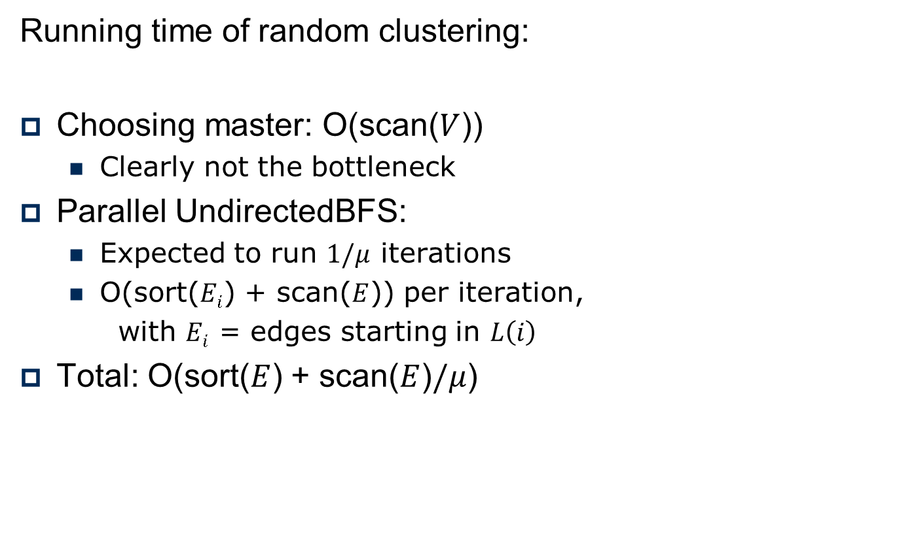
Faster Undirected BFS: Clustering
Running time of random clustering:
Choosing master: O(scan($V$))
Clearly not the bottleneck
Parallel UndirectedBFS:
Expected to run $1/μ$ iterations
O(sort($Ei$) + scan($E$)) per iteration,
with $Ei$ = edges starting in $L\left(i\right)$
Total: O(sort($E$) + scan($E$)$/μ$)

Slide 10
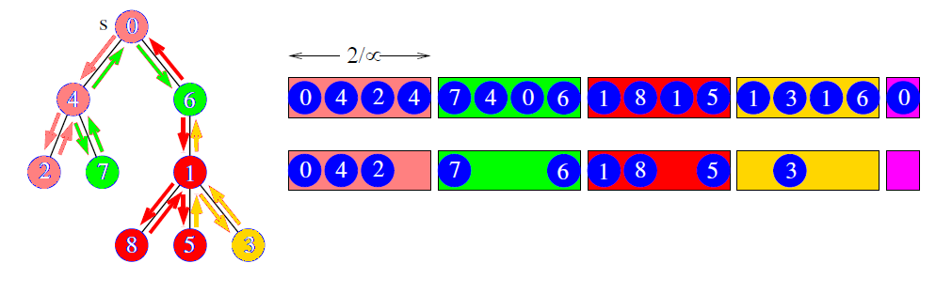
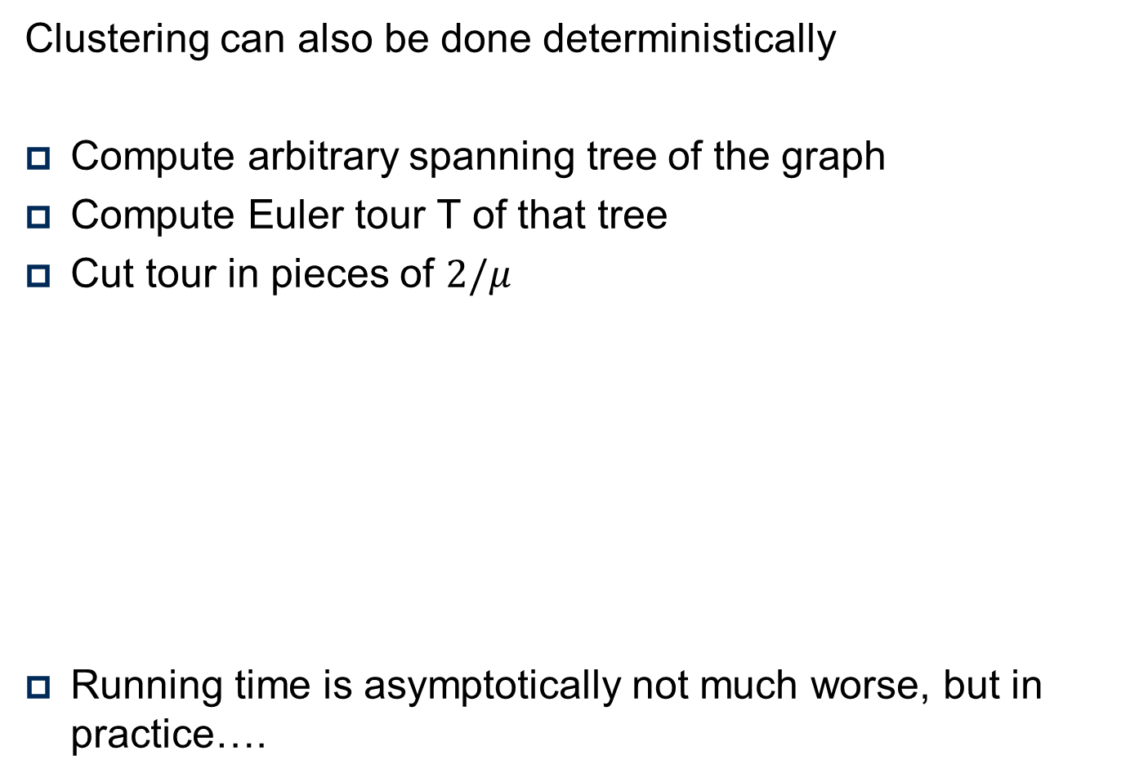
Faster Undirected BFS: Clustering
Clustering can also be done deterministically
Compute arbitrary spanning tree of the graph
Compute Euler tour T of that tree
Cut tour in pieces of $2/μ$
Running time is asymptotically not much worse, but in practice….

Slide 11
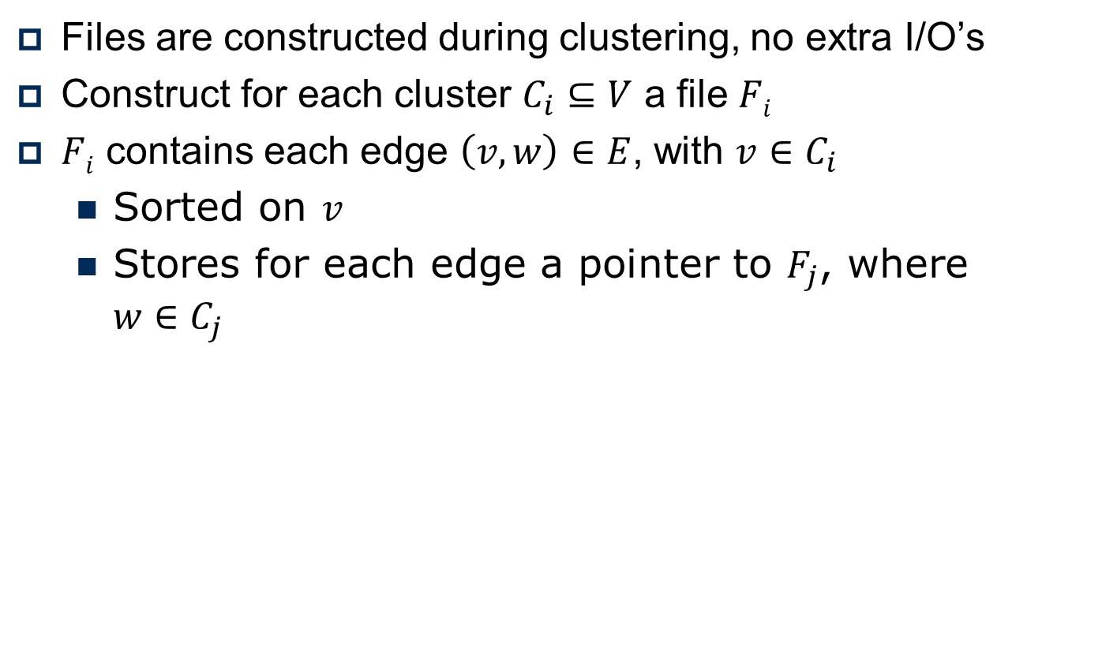
Faster Undirected BFS: Construct files
Files are constructed during clustering, no extra I/O’s
Construct for each cluster $C_{i}⊆V$ a file $Fi$
$Fi$ contains each edge $\left(v, w\right)∈E$, with $v∈C_{i}$
Sorted on $v$
Stores for each edge a pointer to $F_{j}$, where $w∈C_{j}$

Slide 12
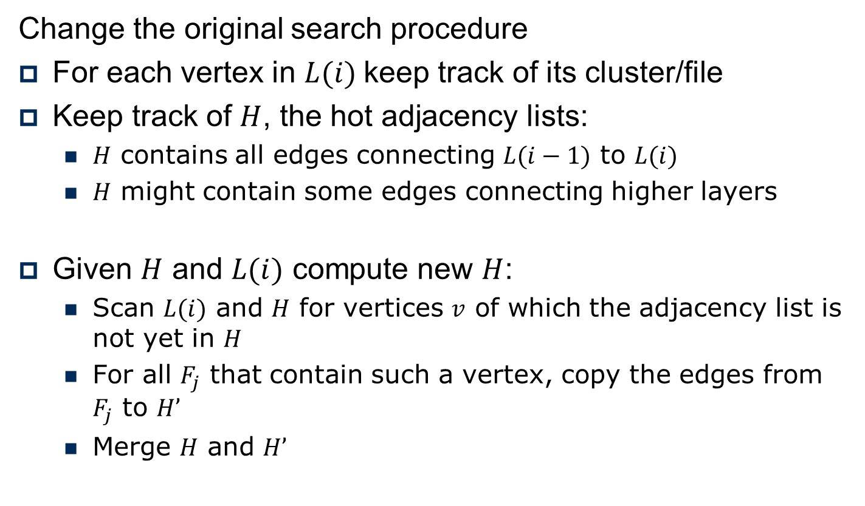
Faster Undirected BFS: Search
Change the original search procedure
For each vertex in $L(i)$keep track of its cluster/file
Keep track of $H$, the hot adjacency lists:
$H$ contains all edges connecting $L(i−1)$ to $L(i)$
$H$ might contain some edges connecting higher layers
Given $H$ and $L(i)$ compute new $H$:
Scan $L(i)$ and $H$ for vertices $v$ of which the adjacency list is not yet in $H$
For all $F_{j}$ that contain such a vertex, copy the edges from $F_{j}$ to $H’$
Merge $H$ and $H’$

Slide 13
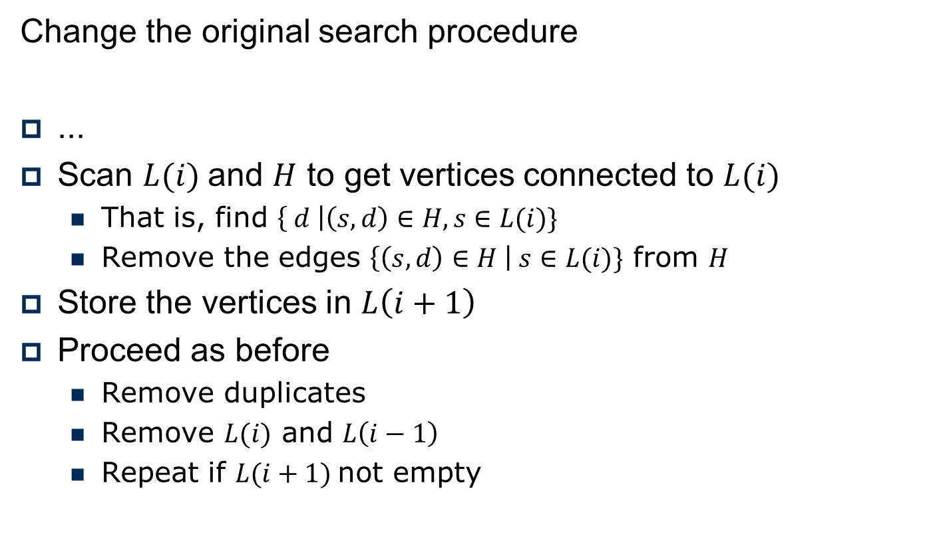
Faster Undirected BFS: Search
Change the original search procedure
...
Scan $L(i)$and $H$ to get vertices connected to $L(i)$
That is, find $\left\{ d \right|\left(s, d\right)∈H, s∈L(i)\}$
Remove the edges $\left\{\left(s, d\right)∈H \right| s∈L(i)\}$ from $H$
Store the vertices in $L\left(i+1\right)$
Proceed as before
Remove duplicates
Remove $L(i)$ and $L\left(i−1\right)$
Repeat if $L(i+1)$not empty

Slide 14
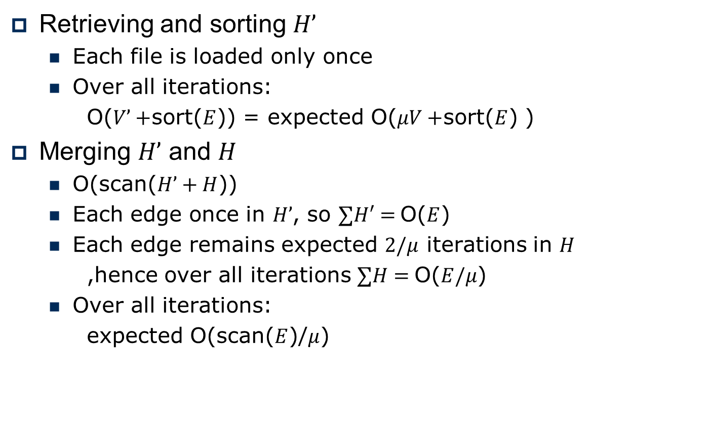
Faster Undirected BFS: Running time
Retrieving and sorting $H’$
Each file is loaded only once
Over all iterations:
O($V’+$sort($E$)) = expected O($μV+$sort($E$) )
Merging $H’$ and $H$
O(scan($H’+H$))
Each edge once in $H’$, so $∑H′=$O($E$)
Each edge remains expected $2/μ$ iterations in $H$
,hence over all iterations $∑H=$O($E/μ$)
Over all iterations:
expected O(scan($E$)/$μ$)

Slide 15
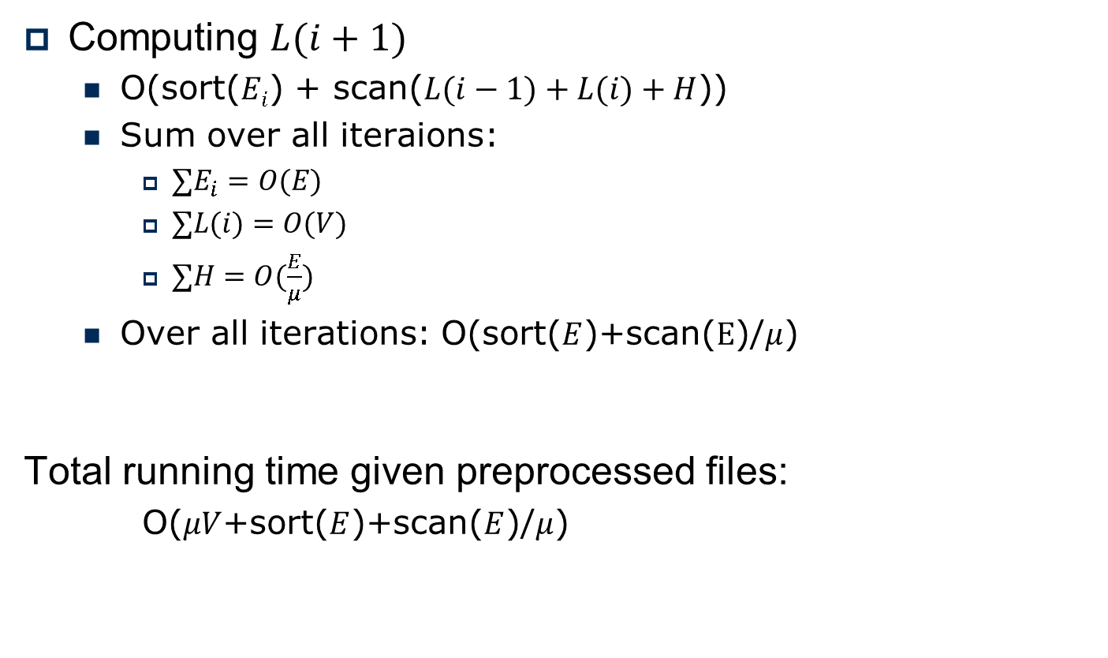
Faster Undirected BFS: Running time
Computing $L(i+1)$
O(sort($Ei$) + scan($L(i−1)+L(i)+H$))
Sum over all iteraions:
$∑E_{i}=O(E)$
$∑L(i)=O(V)$
$∑H=O(\frac{E}{μ})$
Over all iterations: O(sort($E$)+scan($E$)/$μ$)
Total running time given preprocessed files:
O($μV$+sort($E$)+scan($E$)/$μ$)

Slide 16
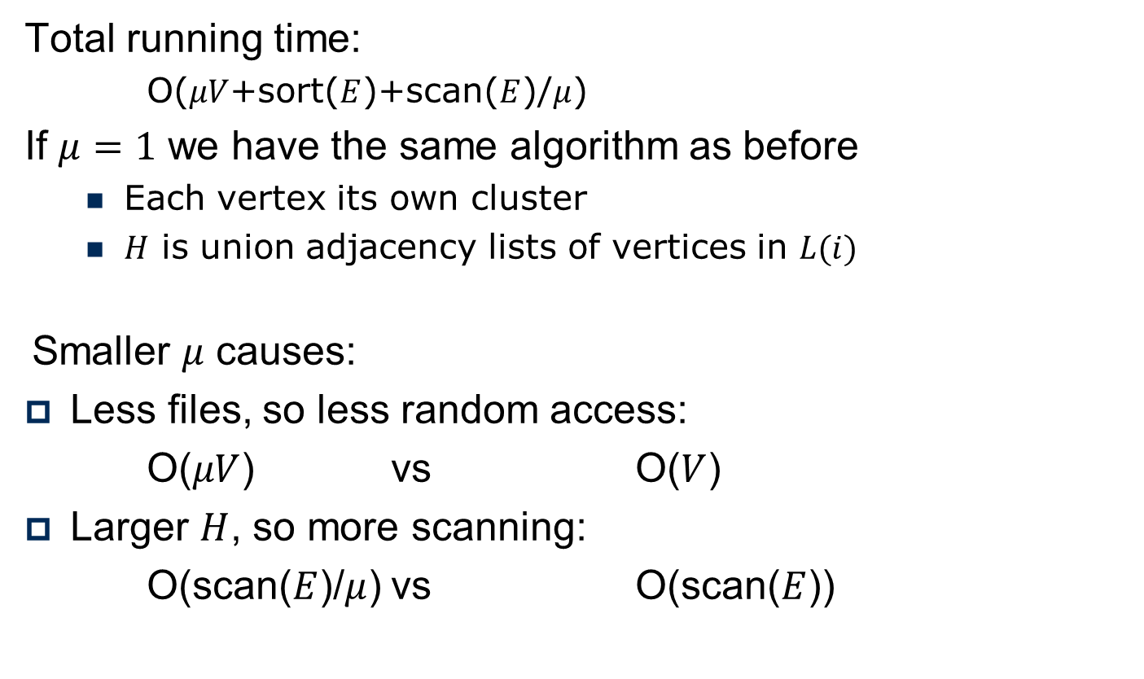
Faster Undirected BFS: Choosing mu
Total running time:
O($μV$+sort($E$)+scan($E$)/$μ$)
If $μ=1$ we have the same algorithm as before
Each vertex its own cluster
$H$ is union adjacency lists of vertices in $L(i)$
Smaller $μ$ causes:
Less files, so less random access:
O($μV$) vs O($V$)
Larger $H$, so more scanning:
O(scan($E$)/$μ$) vs O(scan($E$))

Slide 17
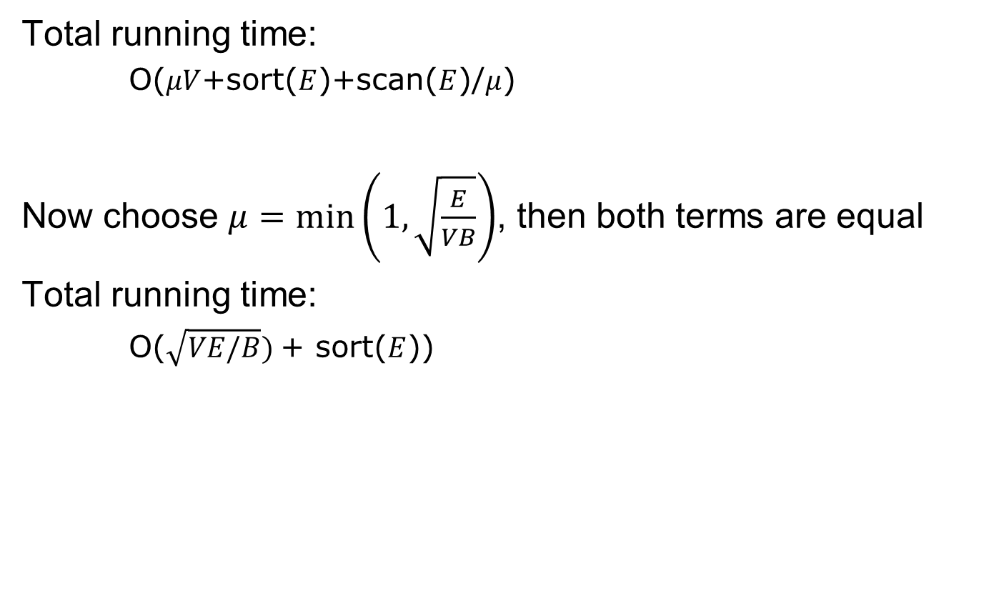
Faster Undirected BFS: Choosing mu
Total running time:
O($μV$+sort($E$)+scan($E$)/$μ$)
Now choose $μ=min\left(1, \sqrt{\frac{E}{VB}}\right)$, then both terms are equal
Total running time:
O($\sqrt{VE/B})$+ sort($E$))

Slide 18







Faster Directed BFS?
Can’t we use the same trick for directed BFS?
No, $L\left(i+1\right)≠ N(L(i))− L(i) − L(i−1)$
$$L(2)$$
$$N(2)$$
$$L(1)$$
$$L(3)$$
$$L(0)$$
$$≠L(3)$$

