Slide 1

Breadth First Search
Maedeh Mehravaran
Big data
1394

Slide 2
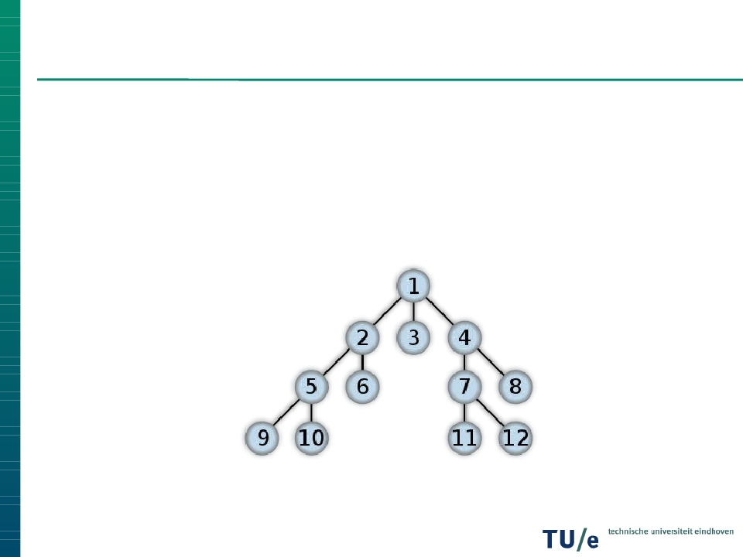
Recall: What is BFS?
BFS is a graph search algorithm
It begins at the root and explores all the neighboring
nodes.
Then for each of those nearest nodes, it explores their
unexplored neighbor nodes, and so on, until it finds the
goal.
The normal in-memory BFS approach takes O(V + E)

Slide 3
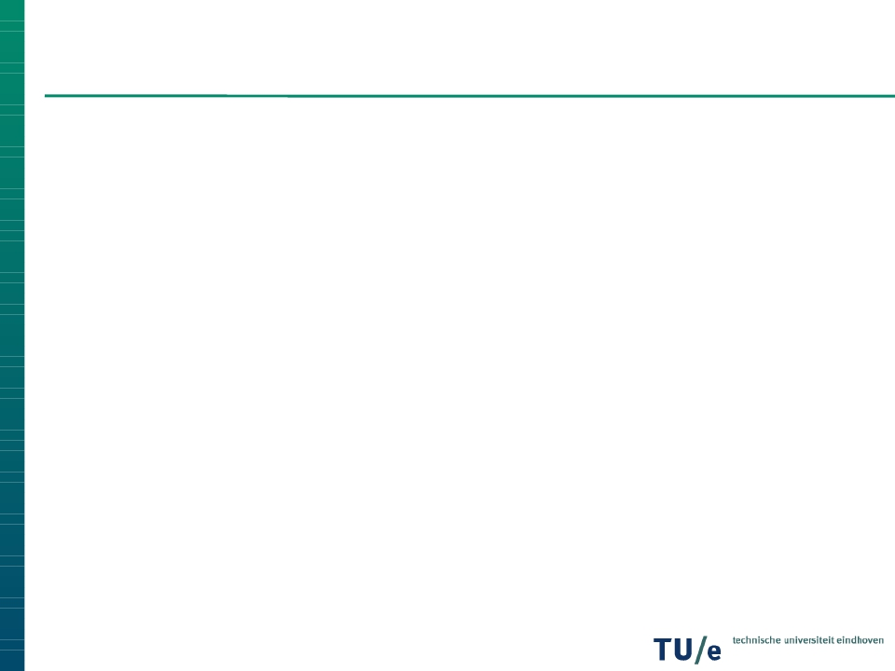
Problems with I/O
Remembering visited nodes.
When is this a problem?
If we can not store V in memory.
We need a data-structure which:
Stores these nodes on disk.
Supports IO efficient inserting and extracting.

Slide 4

Directed BFS: BRT
❐
❐
❐
❐
Goal: Improve #IO operations per edge
Use a BRT T to make it efficient to query if a vertex is
already visited or enqueued to be visited
Invariant: All ingoing edges of all vertices that are
enqueued or are visited are in T
Invariant is used to guarantee that all vertices are visited
exactly once

Slide 5
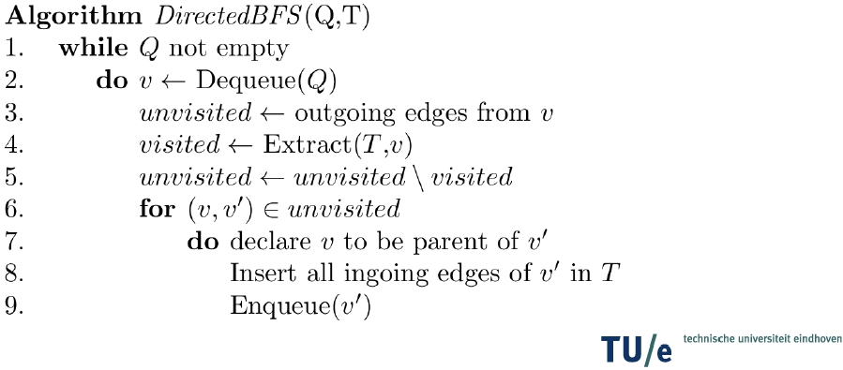
Directed BFS: Code and Correctness
❐
❐
❐
❐
Line 4 looks up outgoing edges that should not be taken
Line 5 removes these edges from the outgoing edges
Line 8 makes sure that the vertex will be visited only once
Together this maintains the invariant

Slide 6
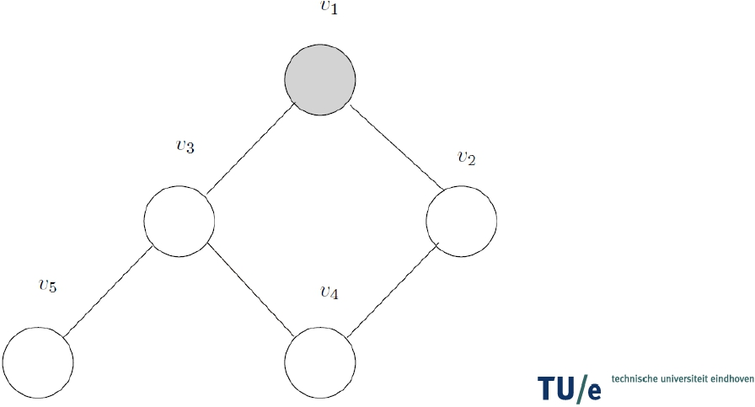
Example
❐
❐
Queue: v1
BRT: []

Slide 7
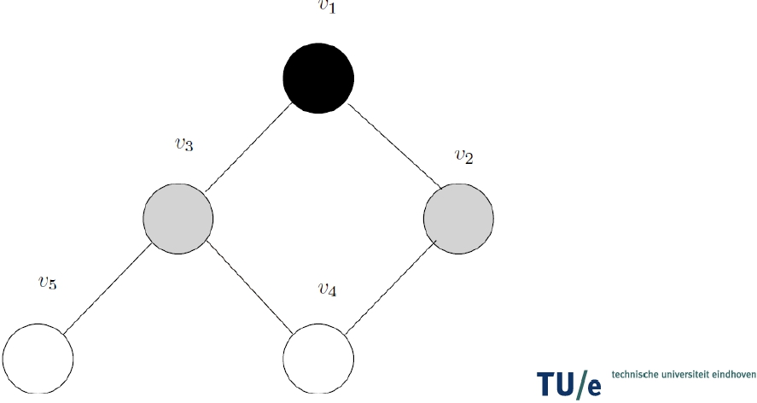
Example
❐
❐
Queue: v2 v3
BRT: (v1,v2) (v1,v3)

Slide 8
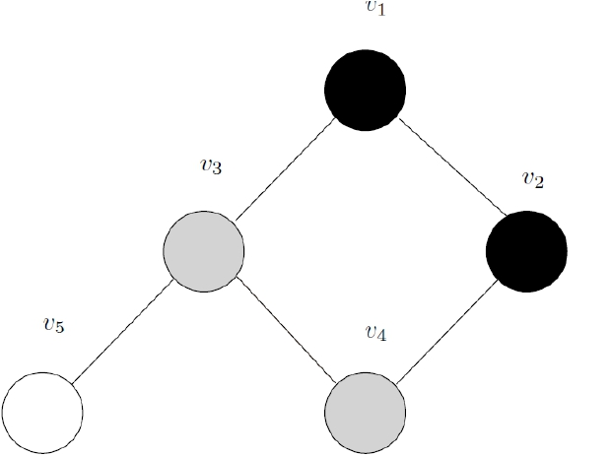
Example
❐
❐
Queue: v3 v4
BRT: (v1,v2) (v1,v3) (v2,v4) (v3 v4)

Slide 9
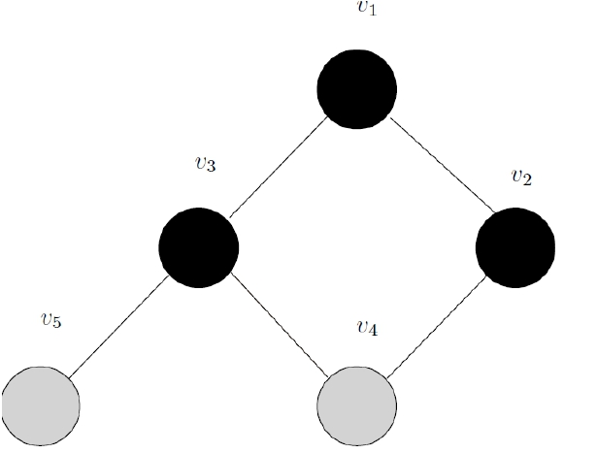
Example
❐
❐
Queue: v4 v5
BRT: (v1,v2) (v1,v3) (v2,v4) (v3, v4) (v3, v5)

Slide 10
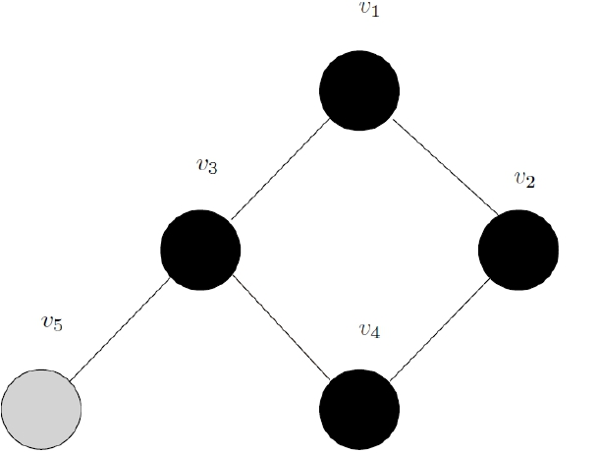
Example
❐
❐
Queue: v5
BRT: (v1,v2) (v1,v3) (v2,v4) (v3, v4) (v3, v5)

Slide 11
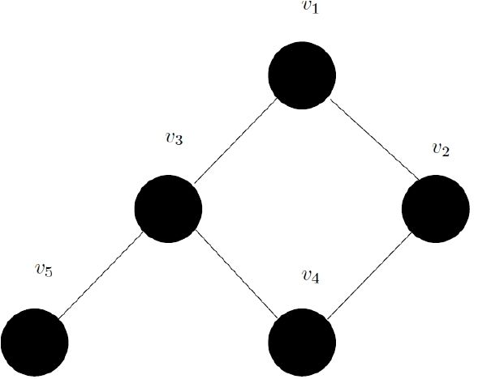
Example
❐
❐
Queue:
BRT: (v1,v2) (v1,v3) (v2,v4) (v3, v4) (v3, v5)

Slide 12
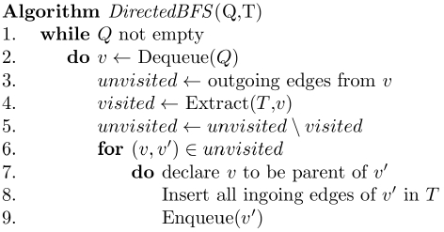
Directed BFS: #IO operations
❐
❐
❐
❐
❐
❐
❐
Line 2,9: O(V/B)
Line 3, retrieving edges:
O(V + E/B)
Line 4, retrieving edges:
O(V) times O(log V)
Line 8: O(E) times
O((1\B) log V)
Line 3,4,5, unvisited: O(V
+ sort(E))
Total: O((V + E/B) log V)
Line 4, 8 are dominant for
IO performance

Slide 13
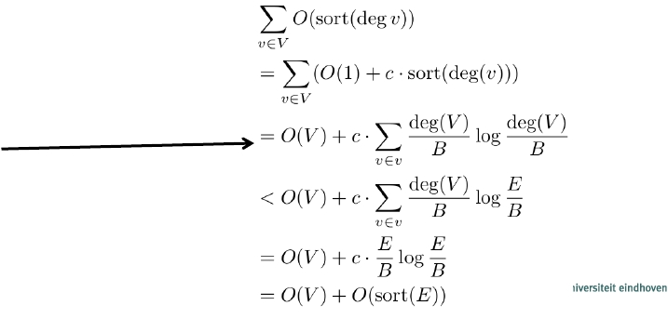
Directed BFS: #IO operations
❐
❐
❐
❐
❐
❐
❐
Line 2,9: O(V/B)
Line 3, retrieving edges:
O(V + E/B)
Line 4, retrieving edges:
O(V) times O(log V) and
O(scan(E))
Line 8: O(E) times
O((1\B) log V)
Line 3,4,5, unvisited: O(V
+ sort(E))
Total: O((V + E/B) log V)
Line 4, 8 are dominant for
IO performance

Slide 14
Comparison: with or without BRT
❐
❐
❐
Slightly worse performance per vertex
Much better performance per edge
In case of dense graphs using a BRT will increase IO
performance
#IO
Operations
Without BRT With BRT
Per Vertex
Per Edge
O(1)
O(1)
O(log V)
O((1/B) log V)

Slide 15
References
External-Memory Graph Algorithms. Y-J. Chiang, M. T. Goodrich, E.F. Grove, R. Tamassia. D. E. Vengroff, and J. S. Vitter. Proc. SODA'95
I/O-Efficient Graph Algorithms. N. Zeh. Lecture notes.
Depth First Search, Teng Li,Ade Gunawan

