Slide 1
Depth First Search
Maedeh Mehravaran
Big data
1394

Slide 2
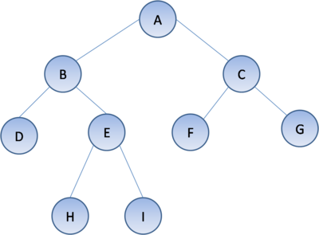
Depth First Search (DFS)
Starts at the source vertex
When there is no edge to unvisited node from the current node, backtrack to most recently visited node with unvisited neighbor(s).
دنباله پیمایش عمقی: A,B,D,E,H,I,C,F,G

Slide 3
Internal Memory Algorithm
Maintain a stack to store the path from source vertex (at stack bottom) to the current visiting vertex (at stack top);
When visiting v, find next unvisited neighbor w, push w in stack and continue with w;
If v has no outgoing edges, or all neighbors are visited, pop v, backtrack;
Ends when stack is empty.

Slide 4
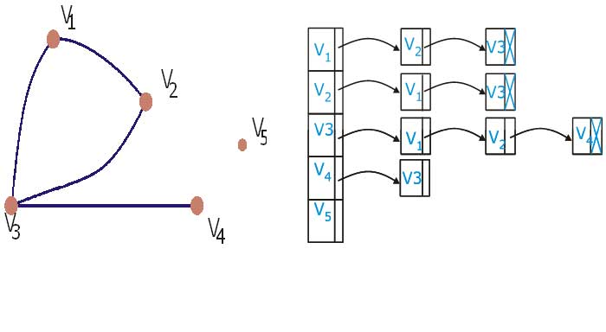
I/O Problems with IM DFS
One I/O for each vertex and edge: O(|V|+|E|)
No solutions to improve O(|V|) so far
Access adjacency lists
But O(|E|) can be reduced
Remember visited nodes

Slide 5
Recall: Buffered Repository Tree (BRT)
BRT is a (2-4) tree
BRT stores id-value pairs at leaves (sorted by id)
Each internal node has a buffer with size B
Only root node is kept in internal memory
Supported operations
Insert(T, id):Insert the given key-value pair in BRT
O(1/B log₂ N/B)
Extract(T, id):Remove all pair with key id
O(log₂ N/B + K/B)
Notes:
A BRT maintains |E| elements with ids in {1,…,|V|}. |V| leaves with buffer size B

Slide 6
Inserting in the BRT
Insert(x)
Insert x into the buffer of r
If buffer overflows => distribute its items to the children of r appropriately.
Recursively distribute overflowing buffers down the tree
Runningtime
Height of BRT is O(log2(N/B))
Emptying buffer of size B takes O(1) I/Os.
=> Charge this to the B elements in the buffer: (1/B) I/Os per element
=> inserted element is charged for O(1/B) I/Os per level
=> Runningtime is O(1/B log2 N/B)
(note that we exclude the I/O's required for rebalancing)

Slide 7
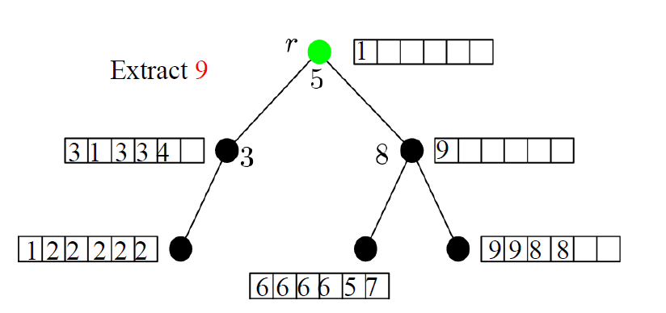
Extracting from the BRT
Extract(x)
Search through leafs that delimit range of items with key x
Extract items from the leafs and the buffers of their ancestors.

Slide 8
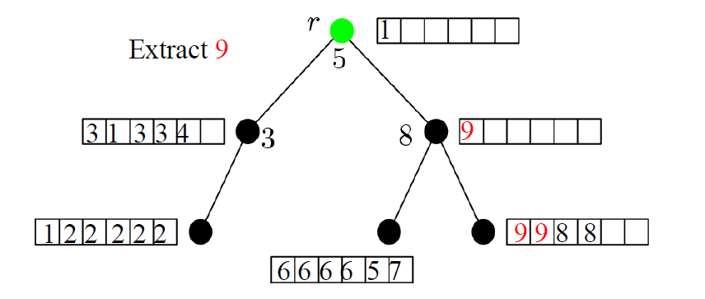
Extracting from the BRT
Extract(x)
Search through leafs that delimit range of items with key x
Extract items from the leafs and the buffers of their ancestors.

Slide 9
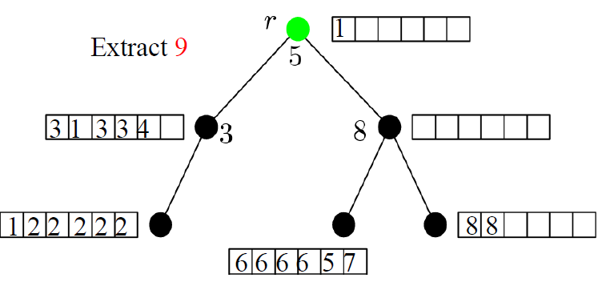
Extracting from the BRT
Extract(x)
Search through leafs that delimit range of items with key x
Extract items from the leafs and the buffers of their ancestors.

Slide 10
Rebalancing
I/Os spent on rebalancing an initially empty BRT during a
sequence of N Inserts and Extract operations is O(N/B)

Slide 11
Priority Queue
Element with highest priority is at the head of queue
Supported operations
Insert(x, p)
DeleteMin
Delete(x)
Implemented with Buffer Tree
Any sequence of z delete/delete_min/insert operations requires O(z/B log_{M/B} z/B) = O(sort(z)) I/Os

Slide 12
I/O efficient directed DFS
Similar to IM algorithm
Build priority queue for each vertex: P(v)
Use P(v) instead of adjacency lists in algorithm
Use BRT to remember all edges pointing to visited nodes
Edges are stored in BRT with source vertex as id.
e.g. <v, (v, w)>
IMPORTANT: at any time, for any vertex v, edges stored in P(v) and not stored in BRT are the edges from v to unvisited nodes

Slide 13
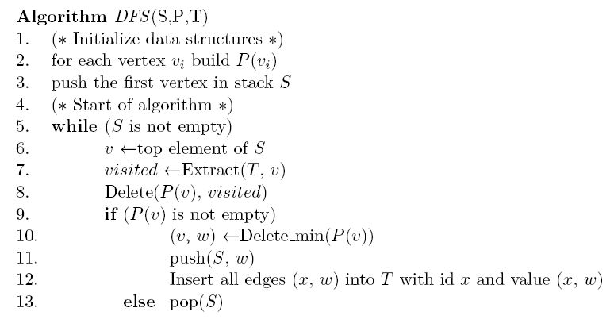
Code

Slide 14
Code
Different with IM algorithm!

Slide 15
Example
P(1)
12
13
1
P(2)
23
24
25
P(3)
2
3
P(4)
P(5)
53
54
4
5
BRT : empty

Slide 16
Example
P(1)
12
13
1
P(2)
23
24
25
P(3)
2
3
P(4)
P(5)
53
54
4
5
BRT : empty
1

Slide 17
Example
P(1)
12
13
1
P(2)
23
24
25
P(3)
2
3
P(4)
P(5)
53
54
4
5
2
BRT : (1, 12)
1

Slide 18
Example
P(1)
12
13
1
P(2)
23
24
25
P(3)
2
3
P(4)
P(5)
53
54
4
5
3
2
BRT : (1, 12) (1, 13) (2, 23) (5, 53)
1

Slide 19
Example
P(1)
12
13
1
P(2)
23
24
25
P(3)
2
3
P(4)
P(5)
53
54
4
5
2
BRT : (1, 12) (1, 13) (2, 23) (5, 53)
1

Slide 20
Example
P(1)
12
13
1
P(2)
23
24
25
P(3)
2
3
P(4)
P(5)
53
54
4
5
4
2
BRT : (1, 12) (1, 13) (2, 24) (5, 53) (5, 54)
1

Slide 21
Example
P(1)
12
13
1
P(2)
23
24
25
P(3)
2
3
P(4)
P(5)
53
54
4
5
2
BRT : (1, 12) (1, 13) (2, 24) (5, 53) (5, 54)
1

Slide 22
Example
P(1)
12
13
1
P(2)
23
24
25
P(3)
2
3
P(4)
P(5)
53
54
4
5
5
2
BRT : (1, 12) (1, 13) (2, 25) (5, 53) (5, 54)
1

Slide 23
Example
P(1)
12
13
1
P(2)
23
24
25
P(3)
2
3
P(4)
P(5)
53
54
4
5
5
2
BRT : (1, 12) (1, 13) (2, 25)
1

Slide 24
Example
P(1)
12
13
1
P(2)
23
24
25
P(3)
2
3
P(4)
P(5)
53
54
4
5
2
BRT : (1, 12) (1, 13) (2, 25)
1

Slide 25
Example
P(1)
12
13
1
P(2)
23
24
25
P(3)
2
3
P(4)
P(5)
53
54
4
5
BRT : (1, 12) (1, 13)
1

Slide 26
Example
P(1)
12
13
1
P(2)
23
24
25
P(3)
2
3
P(4)
P(5)
53
54
4
5
BRT : empty
1

Slide 27
Example
P(1)
12
13
1
P(2)
23
24
25
P(3)
2
3
P(4)
P(5)
53
54
4
5
BRT : empty

Slide 28
Analysis
#I/O accessing adjacency lists
Build up P(v) at the beginning
O(|V| + |E|/B) I/Os
#I/O accessing reverse adjacency lists
Used for retrieving all incoming edges for nodes
O(|V|) I/Os

Slide 29
Analysis
#I/O spent on priority queues
After initialization, only have Delete_min and Delete operations on priority queues until they are empty
O(|E|) operations on priority queues
Therefore:
O(v+sort(|E|))

Slide 30
Analysis
#I/O spent on BRT
O(|E|) inserts and O(|V|) extracts
All inserts: O(|E|/B log₂ |V|)
All extracts: O(|V|log₂ |V|)
In total: O((|V| + |E|/B) log₂ |V|) on BRT
This bounds the total complexity of the algorithm
O((|V| + |E|/B) log₂ |V|) +Sort(|E|))

Slide 31
References
External-Memory Graph Algorithms. Y-J. Chiang, M. T. Goodrich, E.F. Grove, R. Tamassia. D. E. Vengroff, and J. S. Vitter. Proc. SODA'95
I/O-Efficient Graph Algorithms. N. Zeh. Lecture notes.
Depth First Search, Teng Li,Ade Gunawan
The Buffer Tree: A New Technique for Optimal I/O Algorithms, Lars arge,BRICS Report ,August 1996

