Slide 1
I/O-Algorithms
Lars Arge
Spring 2012
January 31, 2012
Notes:
Go though website: Schedule, projects, groups, exam
Breaks: 15, 25
End: 27

Slide 2
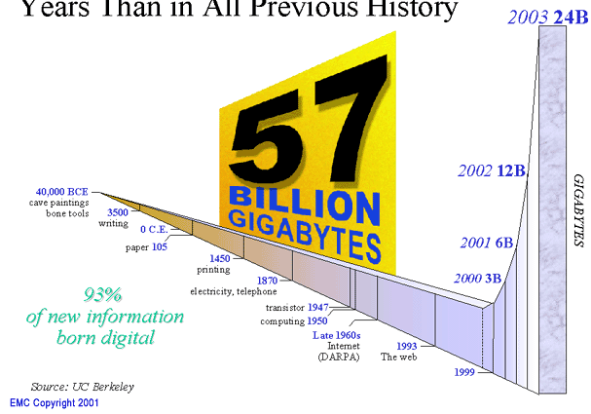




Massive Data
Pervasive use of computers and sensors
Increased ability to acquire/store/process data
→ Massive data collected everywhere
Society increasingly “data driven”
→ Access/process data anywhere any time
Nature/Science special issues
2/06,9/08, 2/11
Scientific data size growing exponentially,
while quality and availability improving
Paradigm shift: Science will be about mining data
Obviously not only in sciences:
Economist 02/10:
From 150 Billion Gigabytes five years ago
to 1200 Billion today
Managing data deluge difficult; doing so
will transform business/public life

Slide 3
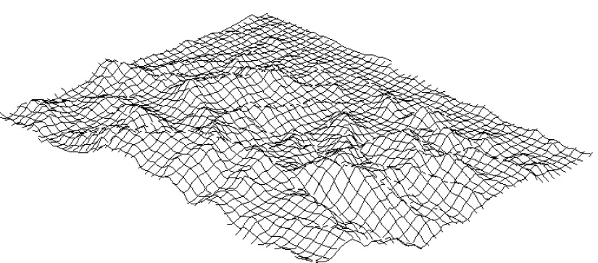

Example: Grid Terrain Data
Appalachian Mountains (800km x 800km)
100m resolution ⇒ ~ 64M cells
⇒ ~128MB raw data (~500MB when processing)
~ 1.2GB at 30m resolution
NASA SRTM mission acquired 30m
data for 80% of the earth land mass
~ 12GB at 10m resolution (much of US available from USGS)
~ 1.2TB at 1m resolution (quickly becoming available)
…. 10-100 points per m² already possible

Slide 4
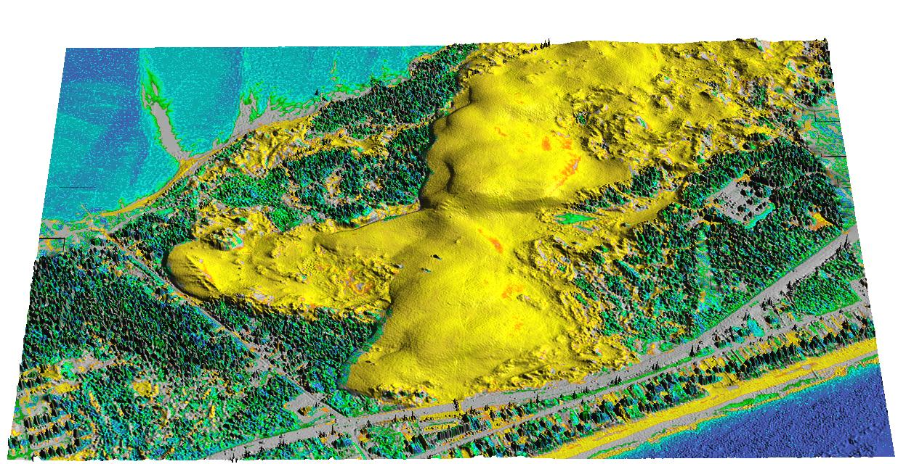
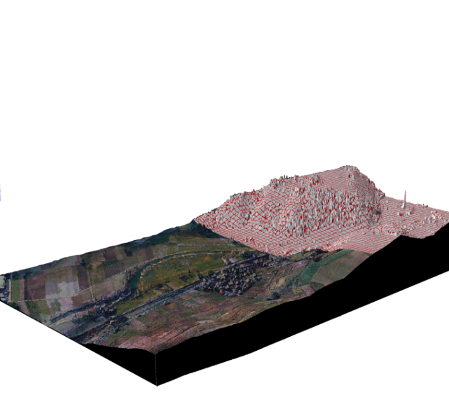


Example: LIDAR Terrain Data
Massive (irregular) point sets (~1m resolution)
Becoming relatively cheap and easy to collect
Sub-meter resolution using mobile mapping
Notes:
Picture: Jockey’s ridge (NC cost)

Slide 5
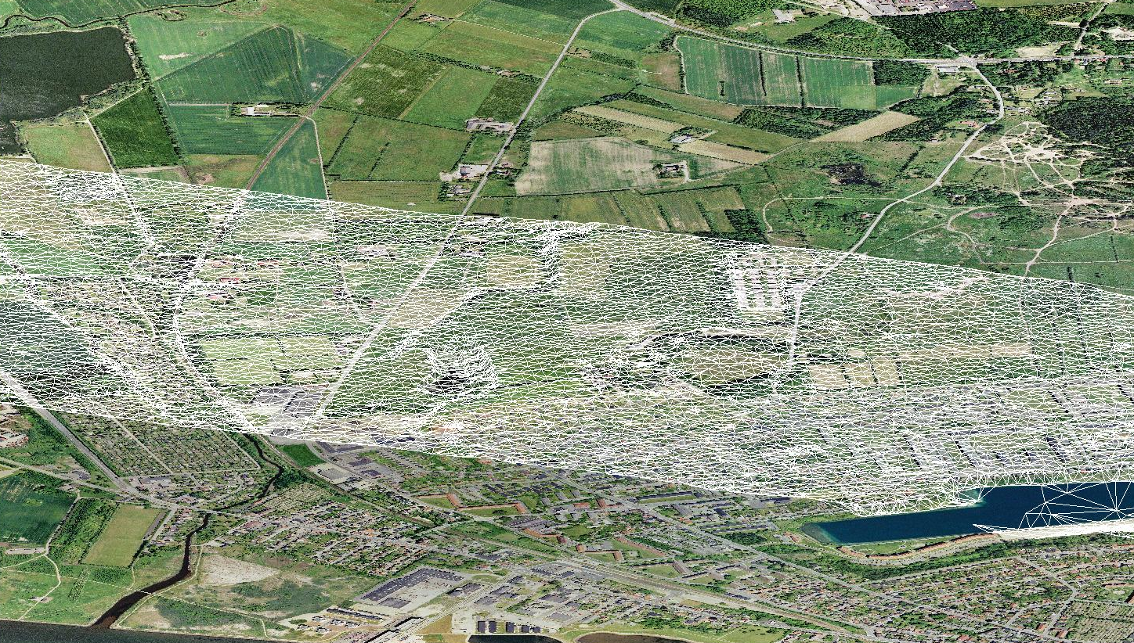
Example: LIDAR Terrain Data
COWI A/S (and others) have scanned Denmark
~ 1,5 m between measurements
~1,2 km
~ 280 km/h at 1500-2000m

Slide 6
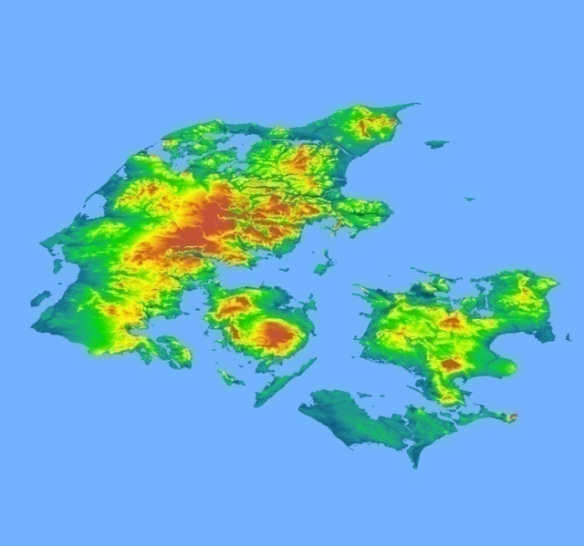
Example: LIDAR Terrain Data
~2 million points at 30 meter (<1GB)
~18 billion points at 1 meter (>1TB)

Slide 7
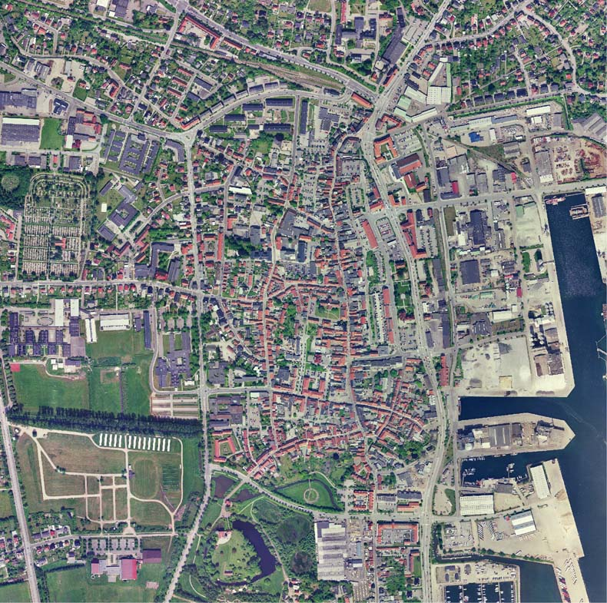
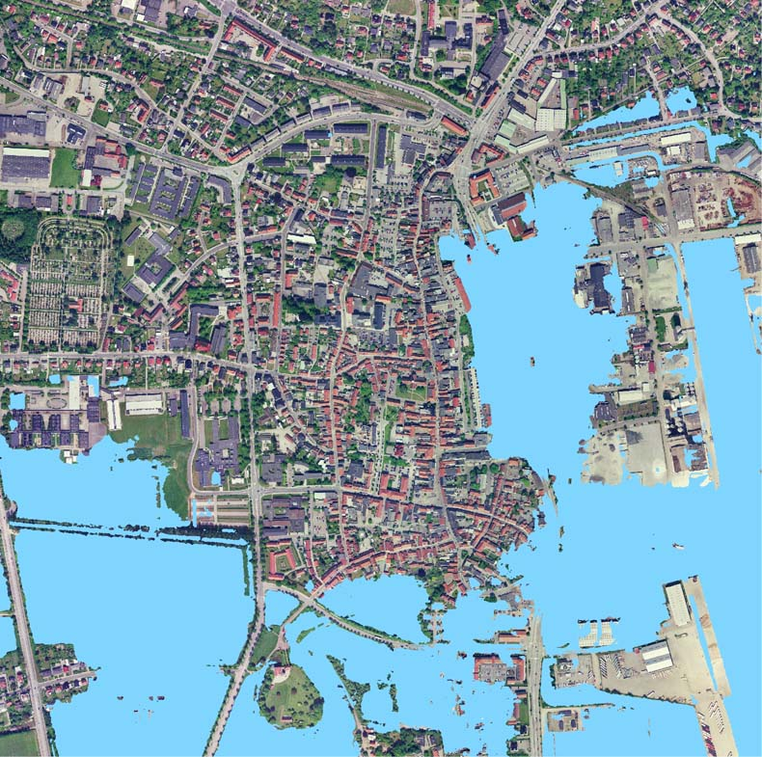
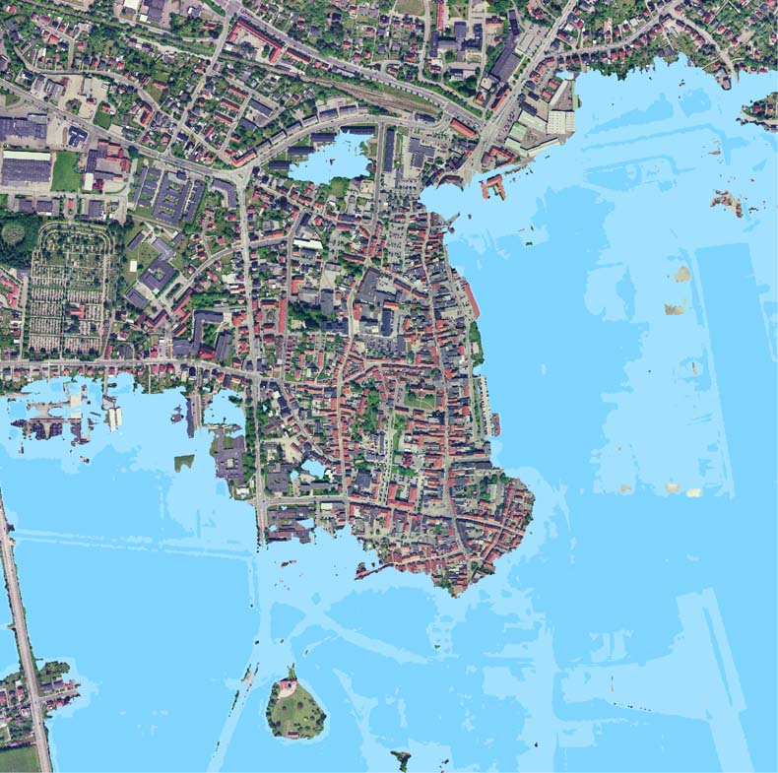
Application Example: Flooding Prediction
+1 meter
+2 meter

Slide 8
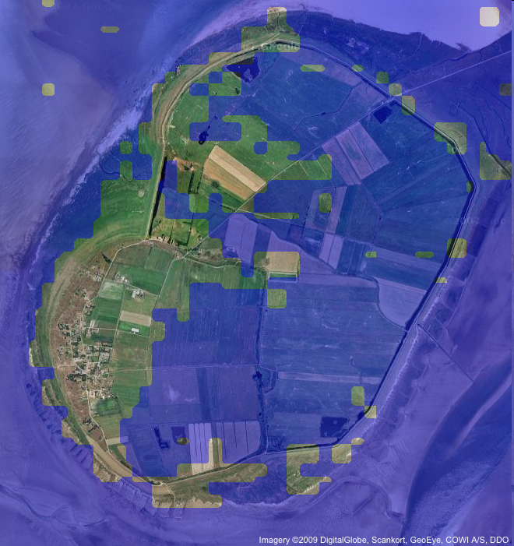
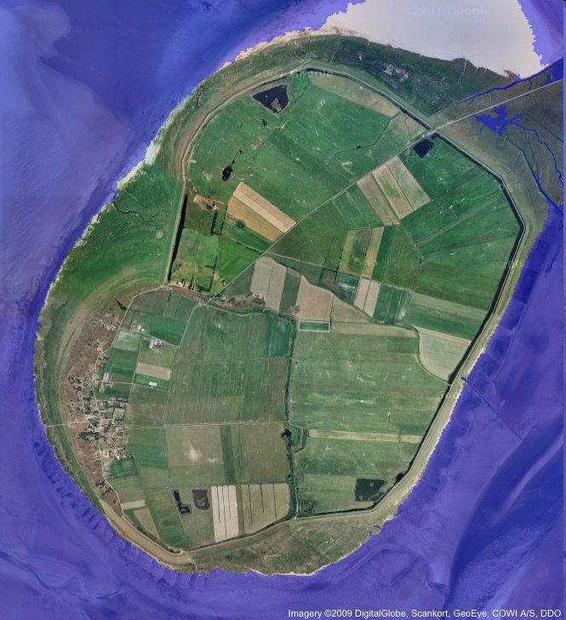
Example: Detailed Data Essential
Mandø with 2 meter sea-level raise
80 meter terrain model 2 meter terrain model

Slide 9
Random Access Machine Model
R
A
M
Standard theoretical model of computation:
Infinite memory
Uniform access cost
Simple model crucial for success of computer industry

Slide 10
Hierarchical Memory
R
A
M
L
1
L
2
Modern machines have complicated memory hierarchy
Levels get larger and slower further away from CPU
Data moved between levels using large blocks

Slide 11
Slow I/O
Disk access is 10⁶ times slower than main memory access
read/write head
track
read/write arm
“The difference in speed between modern CPU and disk technologies is analogous to the difference in speed in sharpening a pencil using a sharpener on one’s desk or by taking an airplane to the other side of the world and using a sharpener on someone else’s desk.” (D. Comer)
magnetic surface
Disk systems try to amortize large access time transferring large contiguous blocks of data (8-16Kbytes)
Important to store/access data to take advantage of blocks (locality)

Slide 12
Scalability Problems
Most programs developed in RAM-model
Run on large datasets because
OS moves blocks as needed
Moderns OS utilizes sophisticated paging and prefetching strategies
But if program makes scattered accesses even good OS cannot take advantage of block access
⇓
Scalability problems!
running time
data size

Slide 13
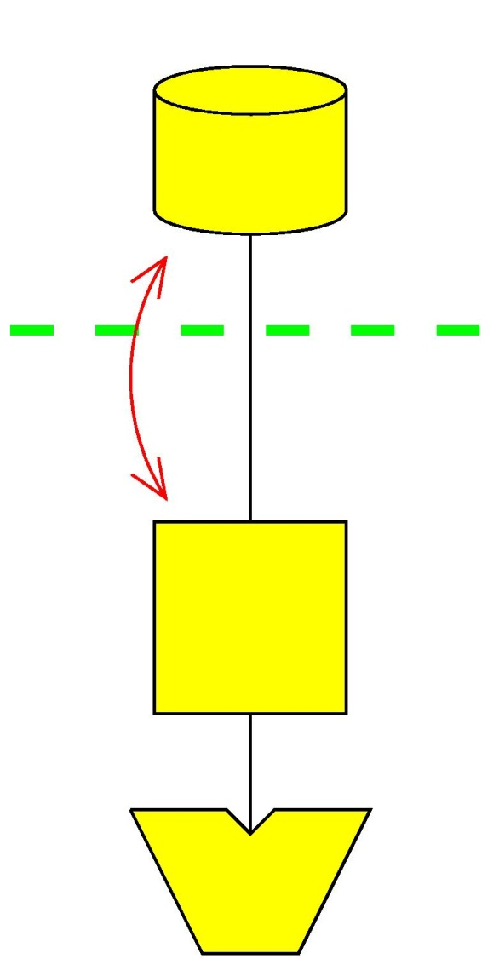
External Memory Model
N = # of items in the problem instance
B = # of items per disk block
M = # of items that fit in main memory
T = # of items in output
I/O: Move block between memory and disk
We assume (for convenience) that M >B²
D
Block I/O
M
P

Slide 14
Fundamental Bounds
Internal External
Scanning: N
Sorting: N log N
Permuting
Searching:
Note:
Linear I/O: O(N/B)
Permuting not linear
Permuting and sorting bounds are equal in all practical cases
B factor VERY important:
Cannot sort optimally with search tree

Slide 15
Scalability Problems: Block Access Matters
Example: Traversing linked list (List ranking)
Array size N = 10 elements
Disk block size B = 2 elements
Main memory size M = 4 elements (2 blocks)
Large difference between N and N/B large since block size is large
Example: N = 256 x 10⁶, B = 8000 , 1ms disk access time
⇒ N I/Os take 256 x 10³ sec = 4266 min = 71 hr
⇒ N/B I/Os take 256/8 sec = 32 sec
1
5
2
6
3
8
9
4
7
10
1
2
10
9
5
6
3
4
8
7
Algorithm 1: N=10 I/Os
Algorithm 2: N/B=5 I/Os

Slide 16
Queues and Stacks
Queue:
Maintain push and pop blocks in main memory
⇓
O(1/B) Push/Pop operations
Stack:
Maintain push/pop blocks in main memory
⇓
O(1/B) Push/Pop operations
Push
Pop
Notes:
Queue: If only push or pop -> one block

Slide 17
Sorting
<M/B sorted lists (queues) can be merged in O(N/B) I/Os
M/B blocks in main memory
Unsorted list (queue) can be distributed using <M/B split elements in O(N/B) I/Os

Slide 18
Sorting
Merge sort:
Create N/M memory sized sorted lists
Repeatedly merge lists together Θ(M/B) at a time
⇒ phases using I/Os each ⇒ I/Os

Slide 19
Sorting
Distribution sort (multiway quicksort):
Compute Θ(M/B) splitting elements
Distribute unsorted list into Θ(M/B) unsorted lists of equal size
Recursively split lists until fit in memory
phases
I/Os if splitting elements computed in O(N/B) I/Os

Slide 20
Computing Splitting Elements
In internal memory (deterministic) quicksort split element (median) found using linear time selection
Selection algorithm: Finding i’th element in sorted order
1) Select median of every group of 5 elements
2) Recursively select median of ~ N/5 selected elements
3) Distribute elements into two lists using computed median
4) Recursively select in one of two lists
Analysis:
Step 1 and 3 performed in O(N/B) I/Os.
Step 4 recursion on at most ~ elements
⇒ I/Os
Notes:
FIGURE?

Slide 21
Sorting
Distribution sort (multiway quicksort):
Computing splitting elements:
Θ(M/B) times linear I/O selection ⇒ O(NM/B²) I/O algorithm
But can use selection algorithm to compute splitting elements in O(N/B) I/Os, partitioning into lists of size <
⇒ phases ⇒ algorithm

Slide 22
Computing Splitting Elements
1) Sample elements:
Create N/M memory sized sorted lists
Pick every ’th element from each sorted list
2) Choose split elements from sample:
Use selection algorithm times to find every
’th element
Analysis:
Step 1 performed in O(N/B) I/Os
Step 2 performed in I/Os
⇒ O(N/B) I/Os

Slide 23
Computing Splitting Elements
1) Sample elements:
Create N/M memory sized sorted lists
Pick every ’th element from each sorted list
2) Choose split elements from sample:
Use selection algorithm times to find every ’th element
sampled elements

Slide 24
Computing Splitting Elements
Elements in range R defined by consecutive split elements
Sampled elements in R:
Between sampled elements in R:
Between sampled element in R and outside R:
⇒
sampled elements
Notes:
(INTRODUCE SYMBOL FOR M/B ECT)
MAKE CLEARER (“BUCKET” ECT)

Slide 25
Summary/Conclusion: Sorting
External merge or distribution sort takes I/Os
Merge-sort based on M/B-way merging
Distribution sort based on -way distribution
and partition elements finding
Optimal
As we will prove next time

Slide 26
References
Input/Output Complexity of Sorting and Related Problems
A. Aggarwal and J.S. Vitter. CACM 31(9), 1998
External partition element finding
Lecture notes by L. Arge and M. G. Lagoudakis.

Slide 27
Project 1: Implementation of Merge Sort

