Slide 1

Voronoi Diagrams The Post Office Problem
POORiA Haddad
Haddad.pooria@yahoo.com
Computer Science Autumn 2014
Yazd University

Slide 2
Outline
Definition and Basic Properties
Computing the Voronoi Diagram
Voronoi Diagrams of Line Segments
Farthest-Point Voronoi Diagrams

Slide 3

What is the Voronoi Diagram?
Yazd Univ.
Computational Geometry
Given ambulance posts in a country, in case of an emergency somewhere, where should the ambulance come from ?
Voronoi Diagrams
Basic Definition
Computing Voronoi
Voronoi of Line Segments
Farthest-Point Voronoi
H
H
H
H
H
H
H
H

Slide 4
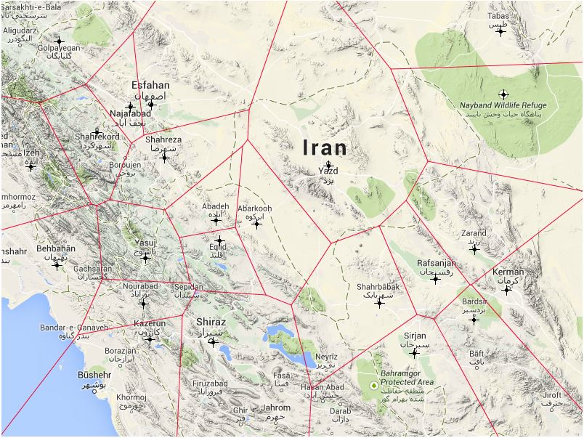
Another Example…
Yazd Univ.
Computational Geometry
Voronoi Diagrams
Basic Definition
Computing Voronoi
Voronoi of Line Segments
Farthest-Point Voronoi
http://lpetrich.org/Science/GeometryDemo/GeometryDemo_GMap.html

Slide 5
Voronoi Diagram structure
Yazd Univ.
Computational Geometry
Edge
Site
Voronoi cell (trading area of site)
Voronoi Diagrams
Basic Definition
Computing Voronoi
Voronoi of Line Segments
Farthest-Point Voronoi
Vertex

Slide 6
Yazd Univ.
Computational Geometry
Definitions:
Voronoi Assignment Model: The model where every point is assigned to the nearest site.
Voronoi Diagram: The subdivision induced by Voronoi Assignment Model
Voronoi Diagrams
Basic Definition
Computing Voronoi
Voronoi of Line Segments
Farthest-Point Voronoi

Slide 7
How to draw Voronoi Diagram?
Yazd Univ.
Computational Geometry
Voronoi Diagrams
Basic Definition
Computing Voronoi
Voronoi of Line Segments
Farthest-Point Voronoi
For 1 point:
No. Site(s): 1 No. Cell(s): 1
No. Vertex(s): 0
No. Edge(s): 0

Slide 8
How to draw Voronoi Diagram?
Yazd Univ.
Computational Geometry
Voronoi Diagrams
Basic Definition
Computing Voronoi
Voronoi of Line Segments
Farthest-Point Voronoi
For 2 points:
No. Site(s): 2 No. Cell(s): 2
No. Vertex(s): 0
No. Edge(s): 1

Slide 9
How to draw Voronoi Diagram?
Yazd Univ.
Computational Geometry
Voronoi Diagrams
Basic Definition
Computing Voronoi
Voronoi of Line Segments
Farthest-Point Voronoi
For 3 points:
No. Site(s): 3 No. Cell(s): 3
No. Vertex(s): 1
No. Edge(s): 3

Slide 10

Primary Definitions
Yazd Univ.
Computational Geometry
Reminder:
Denote the Euclidean distance between two points p and q by dist(p, q):
Voronoi Diagrams
Basic Definition
Computing Voronoi
Voronoi of Line Segments
Farthest-Point Voronoi

Slide 11
Primary Definitions
Yazd Univ.
Computational Geometry
Voronoi Diagram (Vor(P)):
Let P = p₁, p₂, . . . , p_{n} be a set of n distinct points (sites)
Dividing plane into n cells according to following rule: q ∈ V(p_{i} ) if and only if dist(q, p_{i} ) < dist(q, p_{j} )
∀ p_{j} ∈ P, j ≠ i
Voronoi Diagrams
Basic Definition
Computing Voronoi
Voronoi of Line Segments
Farthest-Point Voronoi

Slide 12
Primary Definitions
Yazd Univ.
Computational Geometry
Voronoi Cell of p_{i} :
The cell of Vor(P) that correspond to a site p_{i} is denoted V(p_{i} )
Voronoi Diagrams
Basic Definition
Computing Voronoi
Voronoi of Line Segments
Farthest-Point Voronoi
Perpendicular Bisector of p and q:
The perpendicular of the line segment pq h(p , q): Open half-plane that contains p h(q , p): Open half-plane that contains q r ∈ h(p , q) if and only if dist(r , p) < dist(r, q)

Slide 13

Observation 7.1:
Yazd Univ.
Computational Geometry
Voronoi Diagrams
Basic Definition
Computing Voronoi
Voronoi of Line Segments
Farthest-Point Voronoi

Slide 14
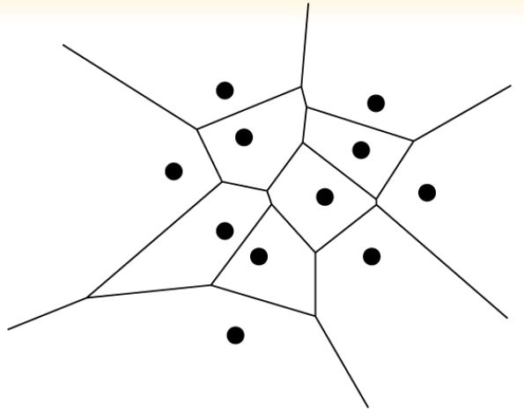
Theorem 7.2:
Let P be a set of n point sites in the plane. If all the sites are collinear then Vor(P) consists of n − 1 parallel lines. Otherwise, Vor(P) is connected and it’s edges are either segments or half-lines.
Yazd Univ.
Computational Geometry
Voronoi Diagrams
Basic Definition
Computing Voronoi
Voronoi of Line Segments
Farthest-Point Voronoi

Slide 15
Proof (part1):
First part is easy to prove
Yazd Univ.
Computational Geometry
Voronoi Diagrams
Basic Definition
Computing Voronoi
Voronoi of Line Segments
Farthest-Point Voronoi

Slide 16
Proof (part2):
First we prove that the edges of Vor(p) are either segments or half-lines.
Suppose for a contradiction that there is an edge e of Vor(p) that is full line.
Yazd Univ.
Computational Geometry
Contradiction
Voronoi Diagrams
Basic Definition
Computing Voronoi
Voronoi of Line Segments
Farthest-Point Voronoi
e
p_{k}
p_{i}
p_{j}

Slide 17
Proof (part2-continue):
It’s remain to prove that Vor(p) is connected.
Yazd Univ.
Computational Geometry
If this were not the case then there would be a Voronoi cell V(p_{i} ) splitting the plane into two. Because Voronoi cells are convex, V(p_{i} ) would consist of a strip bounded by two parallel full lines. But we just proved that the edges of the Voronoi diagram cannot be full lines, a contradiction.
Voronoi Diagrams
Basic Definition
Computing Voronoi
Voronoi of Line Segments
Farthest-Point Voronoi
Why convex?!

Slide 18
Theorem 7.3:
For n ≥ 3, the number of vertices in the Voronoi diagram of a set of n point sites in the plane is at most 2n − 5 and the number of edges is at most 3n − 6
Yazd Univ.
Computational Geometry
Proof (Part I)
If the sites are all collinear then it follows from Theorem 7.2.
Voronoi Diagrams
Basic Definition
Computing Voronoi
Voronoi of Line Segments
Farthest-Point Voronoi

Slide 19
Proof (Part II)
Euler’s formula: m_{v} – m_{e} + m_{f} =2
But Vor(P) has half-infinite edges and is therefore not a proper graph!
Yazd Univ.
Computational Geometry
Voronoi Diagrams
Basic Definition
Computing Voronoi
Voronoi of Line Segments
Farthest-Point Voronoi

Slide 20
Yazd Univ.
Computational Geometry
Voronoi Diagrams
Basic Definition
Computing Voronoi
Voronoi of Line Segments
Farthest-Point Voronoi

Slide 21
Yazd Univ.
Computational Geometry
Proof (Part II)
(n_{v}+1) – n_{e} + n = 2
2n_{e} ≥ 3(n_{v} + 1)
Voronoi Diagrams
Basic Definition
Computing Voronoi
Voronoi of Line Segments
Farthest-Point Voronoi

Slide 22
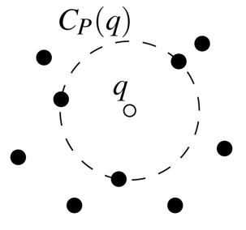
Largest Empty Circle
Yazd Univ.
Computational Geometry
Definition (C_{p}( q)):
Largest empty circle of q with respect to P:
The largest circle with q as its center that does not contain any site of P in its interior
Voronoi Diagrams
Basic Definition
Computing Voronoi
Voronoi of Line Segments
Farthest-Point Voronoi

Slide 23
Theorem 7.4:
For the Voronoi diagram Vor(P) of a set of points P the following holds:
A point q is a vertex of Vor(P) if and only if its largest empty circle C_{p} (q) contains three or more sites on its boundary.
The bisector between sites p_{i} and p_{j} defines an edge of Vor(P) if and only if there is a point q on the bisector such that C_{p}(q) contains both p_{i} and p_{j} on its boundary but no other site.
Yazd Univ.
Computational Geometry
Voronoi Diagrams
Basic Definition
Computing Voronoi
Voronoi of Line Segments
Farthest-Point Voronoi

Slide 24
Proof (part l):
Suppose there is a point q such that C_{p} (q) contains three or more sites on its boundary:
Yazd Univ.
Computational Geometry
Only if :
Sites are p_{i}, p_{j}, p_{k}
Cp(q) is empty and there is no other site nearer to q
So q must be on the boundary of V(p_{i}), V(p_{j}) and V(p_{k})
Hence q must be a vertex of Vor(P)
If :
Every vertex q is incident to at least three edges hence to at least three Voronoi cells V(p_{i}), V(p_{j}) and V(p_{k})
Vertex q must be equidistant to p_{i}, p_{j}, p_{k} and there cannot be another site closer to q
Hence the interior of circle with p_{i}, p_{j}, p_{k} on its boundary does not contain any site.
Voronoi Diagrams
Basic Definition
Computing Voronoi
Voronoi of Line Segments
Farthest-Point Voronoi

Slide 25
Proof (part ll):
Suppose there is a point q with the property stated in the theorem.
Yazd Univ.
Computational Geometry
Only If:
Since Cp(q) does not contain any sites in its interior and p_{i} and p_{j} are on its boundary, we have dist(q,p_{i} ) = dist(q,p_{j} ) ≤ dist(q,p_{k} ) for all 1 ≤ k ≤ n
So q lies on an edge or vertex of Vor(p)
According to the first part q cannot be a vertex, hence q lies on an edge, which is defined by the bisector of p_{i} and p_{j}
If:
Conversely. The bisector of p_{i} and p_{j} define a Voronoi edge
The largest empty circle of any point q in the interior of this edge must contain p_{i} and p_{j} on its boundary and no other sites
Voronoi Diagrams
Basic Definition
Computing Voronoi
Voronoi of Line Segments
Farthest-Point Voronoi

Slide 26
Outline
Definition and Basic Properties
Computing the Voronoi Diagram
Voronoi Diagrams of Line Segments
Farthest-Point Voronoi Diagrams

Slide 27
Different Ways
T(n) = O(n² log n)
Yazd Univ.
Computational Geometry
First Way – Simple Way:
Observation 7.1 suggests a simple way to do this:
For each site p_{i} , compute the common intersection of the half –planes h(p_{i} ,p_{j} ) , with j ≠ I by Chapter 4 algorithm.
Voronoi Diagrams
Basic Definition
Computing Voronoi
Voronoi of Line Segments
Farthest-Point Voronoi

Slide 28
Different Ways
Second Way – Plane Sweep Algorithm:
Commonly known as Fortune’s algorithm.
Computes the Voronoi diagram in O(nlogn) time.
Fortune’s algorithm is optimal.
Yazd Univ.
Computational Geometry
Voronoi Diagrams
Why Fortune’s algorithm is optimal?
The problem of sorting n real numbers is reducible to the problem of computing Voronoi diagrams, so any algorithm for computing Voronoi diagrams must take Ω(nlogn) time in the worst case.
Basic Definition
Computing Voronoi
Voronoi of Line Segments
Farthest-Point Voronoi

Slide 29
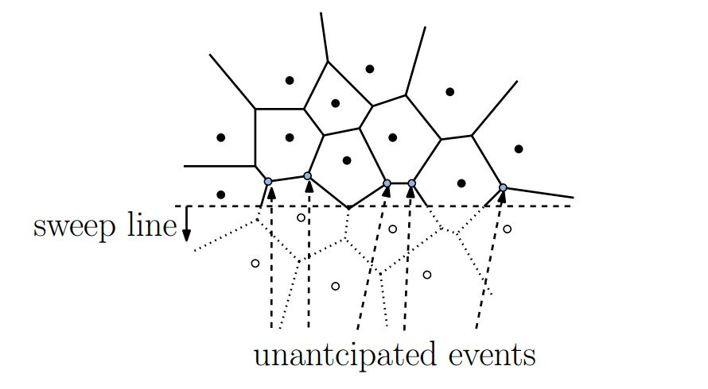
Plane Sweep problems with the Voronoi
Before discussing Fortune’s algorithm, it is interesting to consider why this algorithm was not invented much earlier.
The key to any plane sweep algorithm is the ability to discover all upcoming events in an efficient manner.
The difficulty is that a site that lies below of the sweep line may generate a Voronoi vertex that lies top of the sweep line.
Yazd Univ.
Computational Geometry
Voronoi Diagrams
Basic Definition
Computing Voronoi
Voronoi of Line Segments
Farthest-Point Voronoi

Slide 30
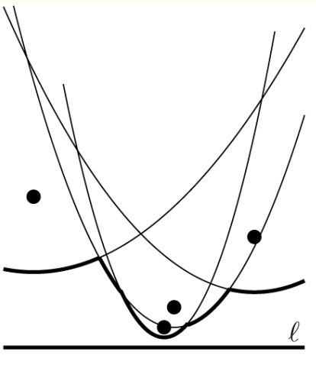
The Solution
Yazd Univ.
Computational Geometry
The Beach Line!
The locus of points that are closer to any site above l than to l itself is bounded by Parabolic Arcs We call this sequence of arcs, the beach line.
Voronoi Diagrams
Basic Definition
Computing Voronoi
Voronoi of Line Segments
Farthest-Point Voronoi

Slide 31
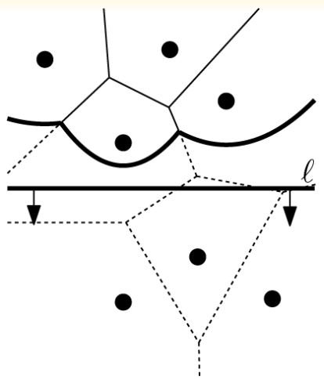
How we can handle it?
l⁺: the closed half-plane above l
What is the part of the Voronoi diagram above l that cannot be changed anymore?
For which points q ∈ l⁺ do we know for sure what their nearest site is?
The nearest site of q cannot lie below l if q is at least as near to some site pi ∈ l⁺ as q is to l
Yazd Univ.
Computational Geometry
Voronoi Diagrams
Basic Definition
Computing Voronoi
Voronoi of Line Segments
Farthest-Point Voronoi

Slide 32
Observation
Observation 7.5 The beach line is x-monotone, that is, every vertical line intersects it in exactly one point
Yazd Univ.
Computational Geometry
Note
Breakpoints between the different parabolic arcs forming the beach line lie on edges of Voronoi Diagram
Breakpoints, exactly trace out the Voronoi Diagram `
Voronoi Diagrams
Basic Definition
Computing Voronoi
Voronoi of Line Segments
Farthest-Point Voronoi

Slide 33
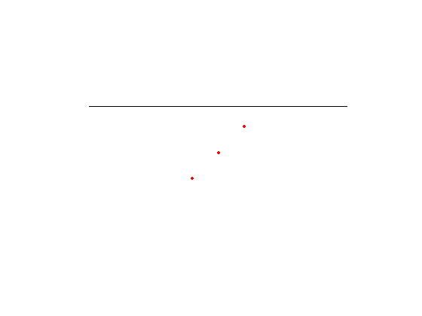
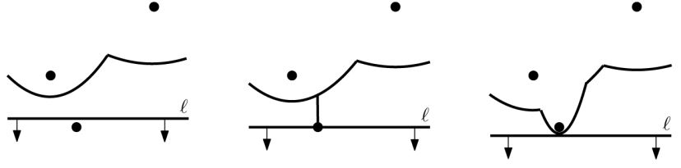
New Arc
When a New Arc Appears on the Beach Line?
One Occasion: When the sweep line l reaches a new site
A degenerate parabola with zero width
Sweep Line moves downward ⇒ New parabola gets wider and wider
Yazd Univ.
Computational Geometry
Voronoi Diagrams
Basic Definition
Computing Voronoi
Voronoi of Line Segments
Farthest-Point Voronoi

Slide 34
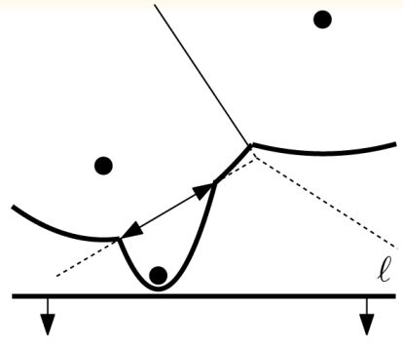
New Arc (Cont.)
What Happens to the Voronoi Diagram at Site Event?
The two new breakpoints coincide at first
Then move in opposite directions to trace out the same edge
Yazd Univ.
Computational Geometry
Note
Initially, this edge is not connected to the rest of Voronoi Diagram above the sweep line.
Voronoi Diagrams
Basic Definition
Computing Voronoi
Voronoi of Line Segments
Farthest-Point Voronoi

Slide 35
New Arc Lemma
Lemma 7.6 The only way in which the new arc can appear on the beach line is through a site event.
Yazd Univ.
Computational Geometry
Proof
(Contradiction) An already existing parabola βj defined by a site p_{j} breaks through the beach line, There are two ways in which this could happen:
Voronoi Diagrams
Basic Definition
Computing Voronoi
Voronoi of Line Segments
Farthest-Point Voronoi

Slide 36
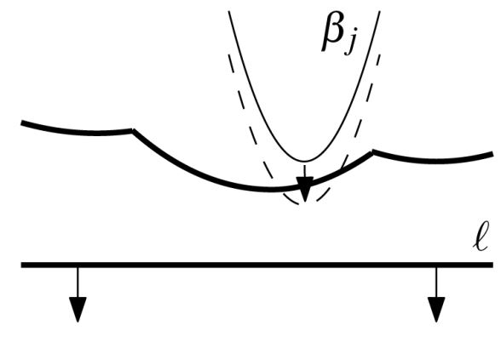

Proof
Proof (Part I)
βj breaks through in the middle of an arc of a parabola βi
l_{y}: y-coordinate of sweep line (at the moment of tangency)
p_{j} := (p_{j,x}, p_{j,y})
Yazd Univ.
Computational Geometry
Voronoi Diagrams
Basic Definition
Computing Voronoi
Voronoi of Line Segments
Farthest-Point Voronoi
Result
p_{i,y} and p_{j,y} are larger than l_{y} ⇒It is impossible that βi, βj have only one point of intersect

Slide 37
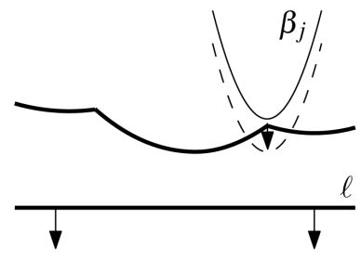
Proof (Cont.)
Proof (Part II)
βj appears in between two arcs (βi , βk)
Yazd Univ.
Computational Geometry
Voronoi Diagrams
Basic Definition
Computing Voronoi
Voronoi of Line Segments
Farthest-Point Voronoi

Slide 38
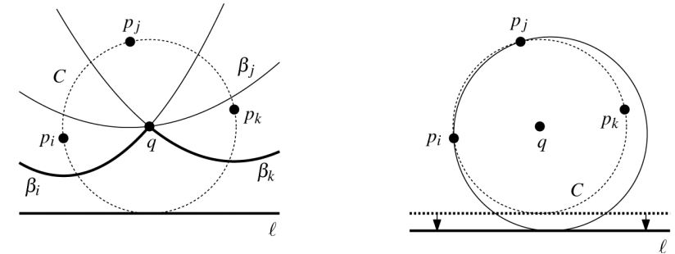
Proof (Cont.)
Result
In a sufficiently small neighborhood of q the parabola βj cannot appear on the beach line when the sweep line moves downward
Proof (Part II) (Cont.)
Consider an infinitesimal motion of sweep line downward while keeping the circle C tangent to l
Either p_{i} or p_{k} will penetrate the interior
Yazd Univ.
Computational Geometry
Voronoi Diagrams
Basic Definition
Computing Voronoi
Voronoi of Line Segments
Farthest-Point Voronoi

Slide 39
Consequence
Maximum of Parabolic Number
An immediate consequence of the lemma is that the beach line consists of at most 2n-1 parabolic arcs.
Yazd Univ.
Computational Geometry
Voronoi Diagrams
Basic Definition
Computing Voronoi
Voronoi of Line Segments
Farthest-Point Voronoi

Slide 40
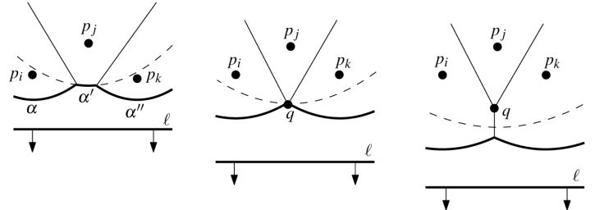
Circle Event
Assumption
α’ Disappearing arc α , α” Two neighboring arcs of α ‘ q Is equidistant from l and each of three sites
Yazd Univ.
Computational Geometry
Circle Event
Where the sweep line reaches the lowest point of a circle through three sites defining consecutive arcs on the beach line
Voronoi Diagrams
Basic Definition
Computing Voronoi
Voronoi of Line Segments
Farthest-Point Voronoi

Slide 41
Circle Event Lemma
Yazd Univ.
Computational Geometry
Lemma 7.7
The only way in which an existing arc can disappear from the beach line is through a circle event .
Voronoi Diagrams
Events
Site event
New arc appears
New edge starts to grow
Circle event
Existing arc drops out
Two growing edges meet to form a vertex
Basic Definition
Computing Voronoi
Voronoi of Line Segments
Farthest-Point Voronoi

Slide 42
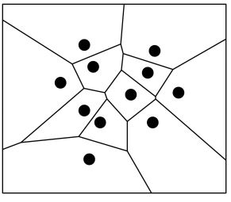
Data Structure
Yazd Univ.
Computational Geometry
Voronoi Diagram
Data Structure: Doubly-connected edge list(DCEL)
Voronoi Diagrams
Basic Definition
Computing Voronoi
Voronoi of Line Segments
Farthest-Point Voronoi

Slide 43
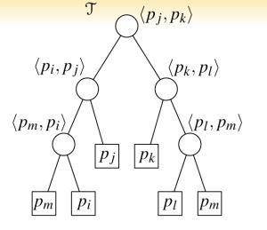
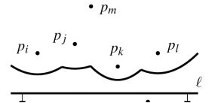
Data Structure (Cont.)
Beach Line
Data Structure: Balanced binary search tree T; it is the status structure
Leaves of T: Arcs
Internal nodes of T:Breakpoints
Yazd Univ.
Computational Geometry
Voronoi Diagrams
Basic Definition
Computing Voronoi
Voronoi of Line Segments
Farthest-Point Voronoi

Slide 44
Data Structure
Event Queue
Data Structure: Priority queue(Priority of an event is its y-coordinate)
For a Site event we store site itself
For a Circle event we store the lowest point of the circle, with a pointer to the leaf in T that represents the arc that will disappear in the event.
Yazd Univ.
Computational Geometry
Voronoi Diagrams
Basic Definition
Computing Voronoi
Voronoi of Line Segments
Farthest-Point Voronoi

Slide 45
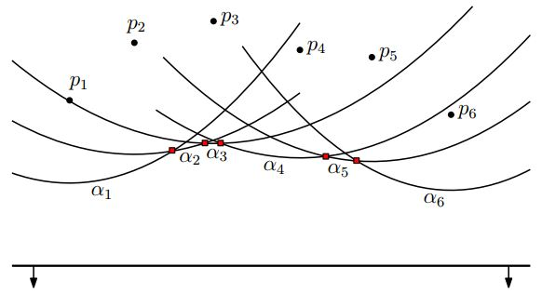
Circle Event Detection
Yazd Univ.
Computational Geometry
Voronoi Diagrams
Basic Definition
Computing Voronoi
Voronoi of Line Segments
Farthest-Point Voronoi

Slide 46
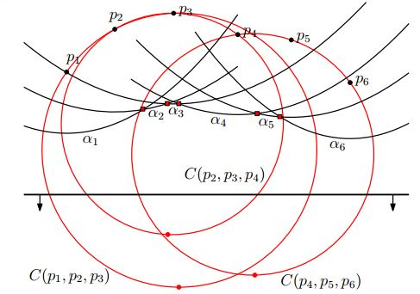
Circle Event Detection(Cont.)
Yazd Univ.
Computational Geometry
Voronoi Diagrams
Basic Definition
Computing Voronoi
Voronoi of Line Segments
Farthest-Point Voronoi

Slide 47
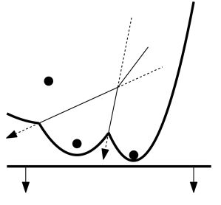
Circle Event Detection(Cont.)
Event Cases
Consecutive triples whose two breakpoints do not coverage
Circle event can disappear before the event has taken place(False Alarm)
Yazd Univ.
Computational Geometry
Voronoi Diagrams
Basic Definition
Computing Voronoi
Voronoi of Line Segments
Farthest-Point Voronoi

Slide 48
False Alarm
Reasons
There are two reasons for false alarms: 1. Site events 2. Other circle events
Yazd Univ.
Computational Geometry
Voronoi Diagrams
Basic Definition
Computing Voronoi
Voronoi of Line Segments
Farthest-Point Voronoi

Slide 49
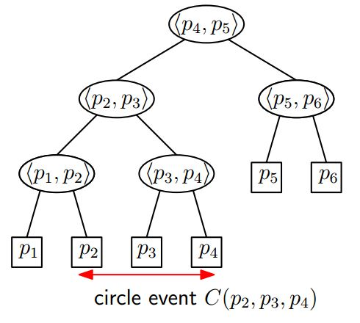
False Alarm Reason 1
Status (Before)
A site event that disrupts three consecutive parabolic arcs
Yazd Univ.
Computational Geometry
Voronoi Diagrams
Basic Definition
Computing Voronoi
Voronoi of Line Segments
Farthest-Point Voronoi

Slide 50
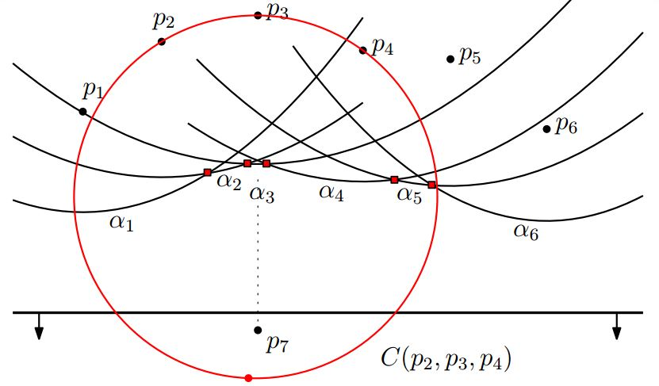
False Alarm Reason 1
Yazd Univ.
Computational Geometry
Voronoi Diagrams
Basic Definition
Computing Voronoi
Voronoi of Line Segments
Farthest-Point Voronoi

Slide 51
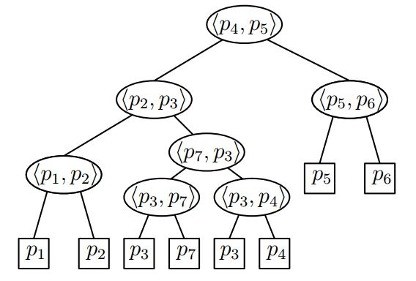
False Alarm Reason 1
Status (After)
A site event that disrupts three consecutive parabolic arcs
Yazd Univ.
Computational Geometry
Voronoi Diagrams
Basic Definition
Computing Voronoi
Voronoi of Line Segments
Farthest-Point Voronoi

Slide 52
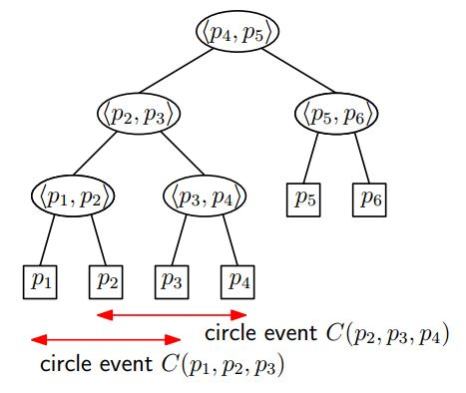
False Alarm Reason 2
Status (Before)
A circle event that disrupts three consecutive parabolic arcs
Yazd Univ.
Computational Geometry
Voronoi Diagrams
Basic Definition
Computing Voronoi
Voronoi of Line Segments
Farthest-Point Voronoi

Slide 53
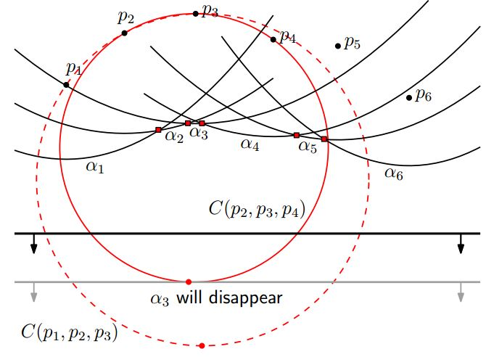
False Alarm Reason 2
Yazd Univ.
Computational Geometry
Voronoi Diagrams
Basic Definition
Computing Voronoi
Voronoi of Line Segments
Farthest-Point Voronoi

Slide 54
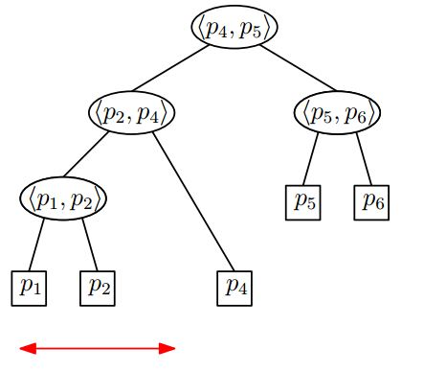
False Alarm Reason 2
Status (After)
A circle event that disrupts three consecutive parabolic arcs
Yazd Univ.
Computational Geometry
Voronoi Diagrams
Basic Definition
Computing Voronoi
Voronoi of Line Segments
Farthest-Point Voronoi

Slide 55
The End
POORiA Haddad
Haddad.pooria@yahoo.com
Computer Science Autumn 2014
Yazd University

